Slide 1

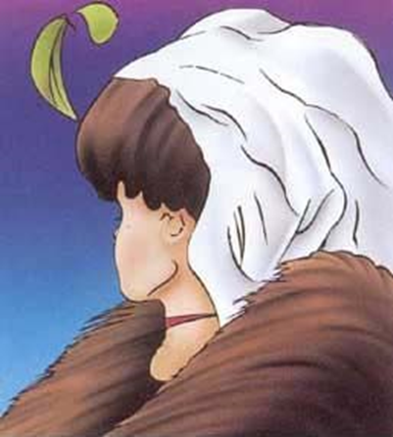


Sinä olet, siis minäkin olen
Viernes 17 de septiembre
10.15–11.45 (Tovi)
➔ Receptive multilingualism
Viernes 24 de septiembre
08.15-09.45
➔ Multilingual and multicultural
Miguel López
Universidad de Jyväskylä

Slide 2


Slide 3
Strategies for reading a text (a text is a text is a text)
“use strategies in different languages for global overall view of content of text
  title, subtitle, table of contents, summary, introduction, first sentences, typical concepts and terminology, eye-catchers, graphics and pictorial cues, bibliography, reputation of author, editor, etc.
  identify and make use of text type conventions (discourse markers, text organization, cohesive devices, etc.) “

Slide 4


Slide 5


Slide 6


Slide 7
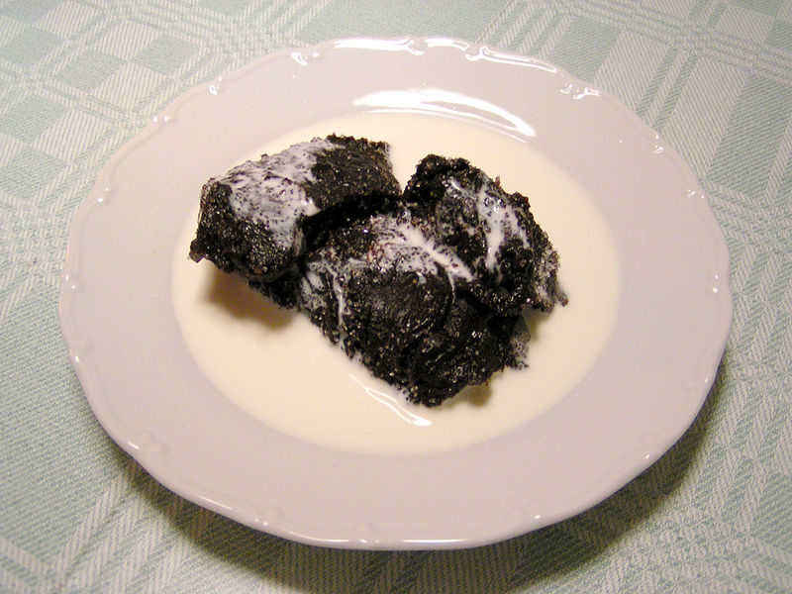

Slide 8
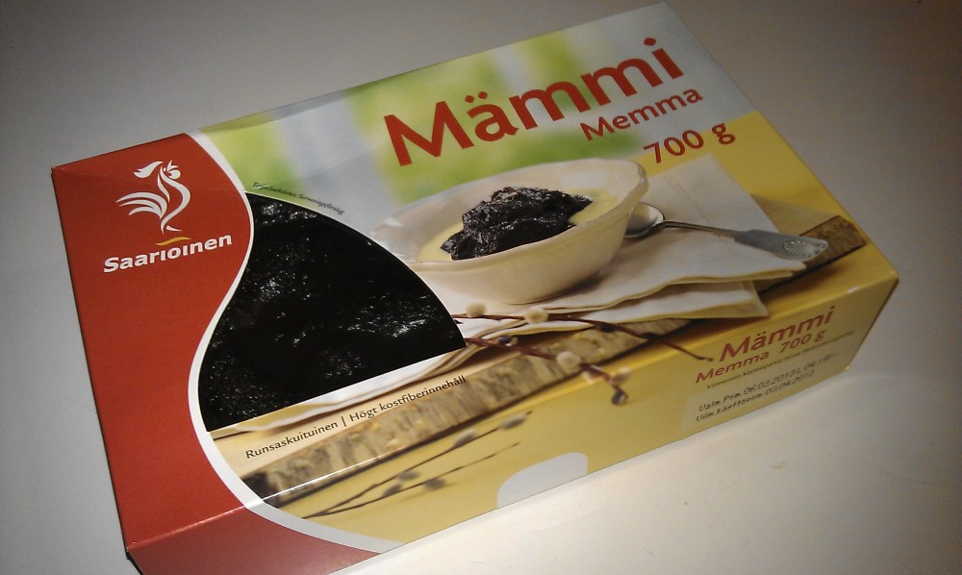

Slide 9
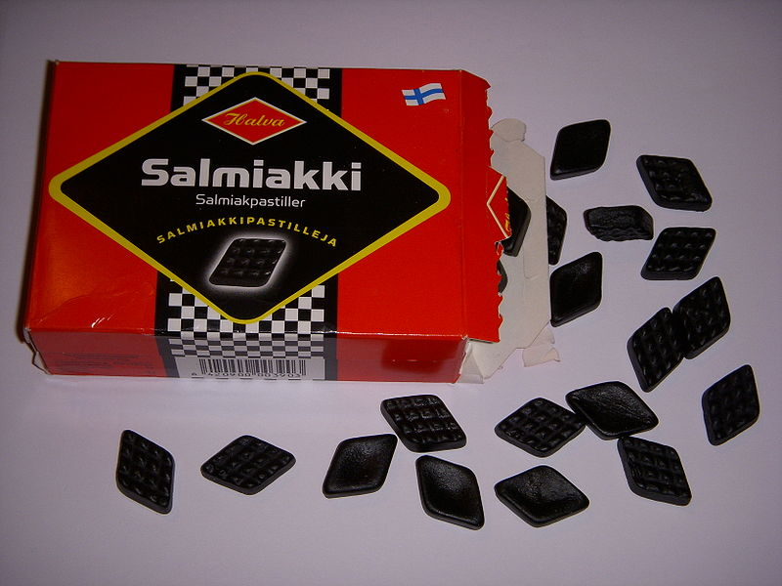

Slide 10
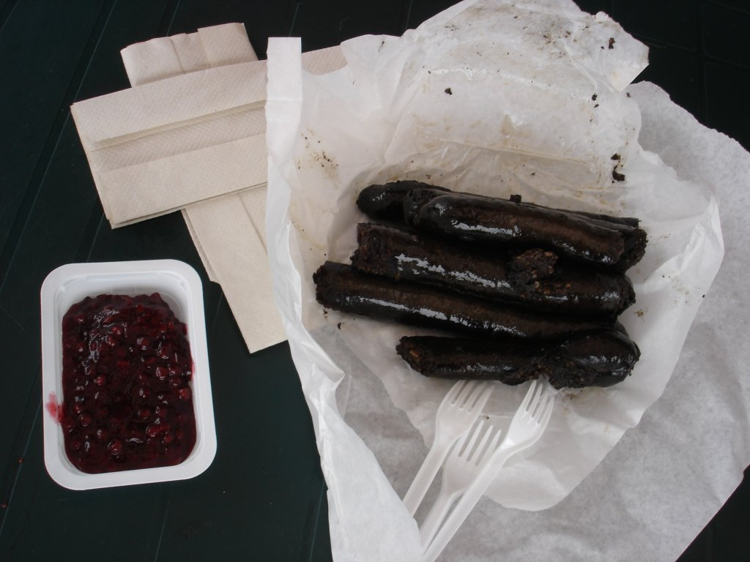

Slide 11
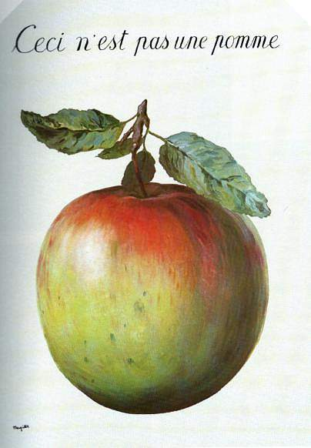
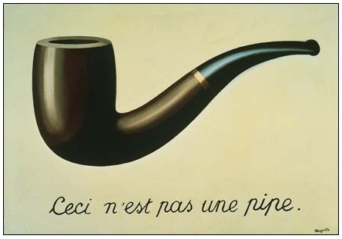
MEANING

Slide 12
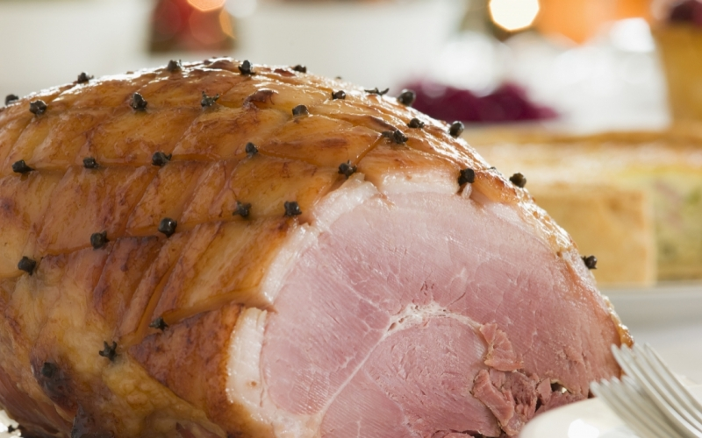

Slide 13
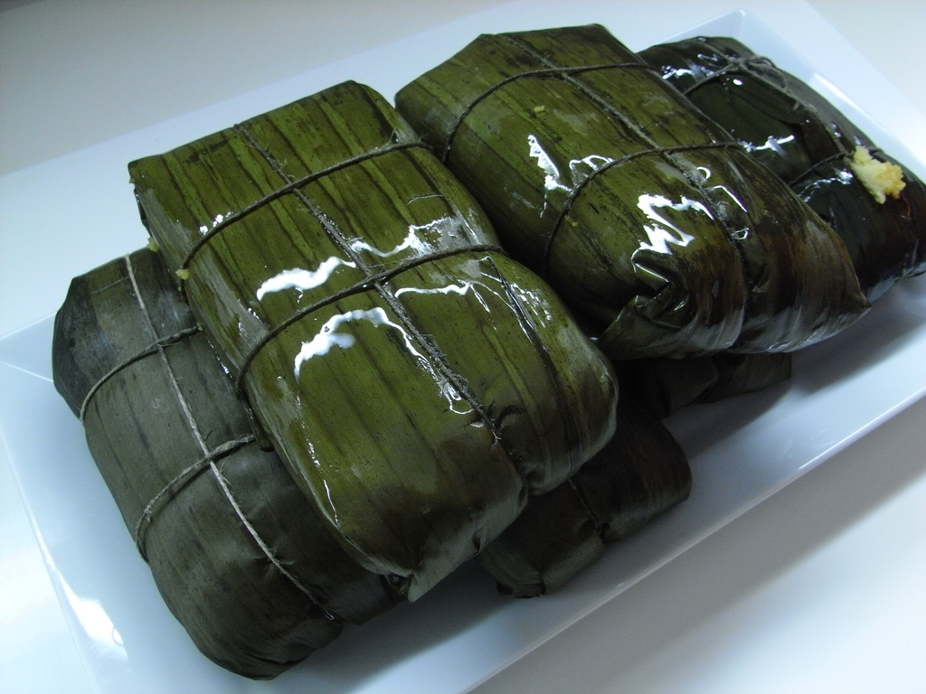

Slide 14


Slide 15
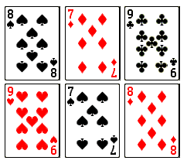

Slide 16
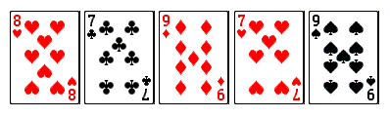

Slide 17
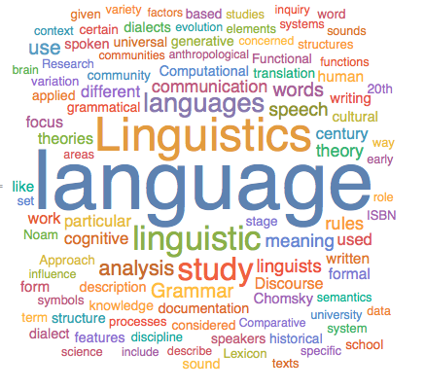
  Ability to analyse/to compare linguistic elements in languages
  Ability to assess progress and plan further learning

Slide 18
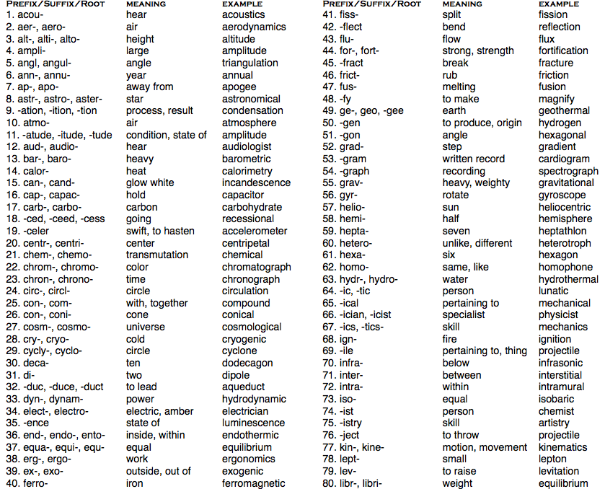

Slide 19
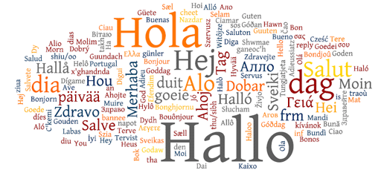


  Attention to languages, to linguistic diversity in general
  Acknowledging the value of language competence, even partial
  Awareness of one’s existing linguistic resources

Slide 20
knowledge of different languages -the individual repertoire, including L1- to optimize comprehension of a written text:
  establishing regularities, similarities and contrasting between languages (text type conventions, lexical knowledge including concepts and terminology, grammar structures (construction rules, word order, etc.), paragraph structures, etc.)
  identify contextual, grammatical and lexical cues and infer from them to establish meaning

Slide 21
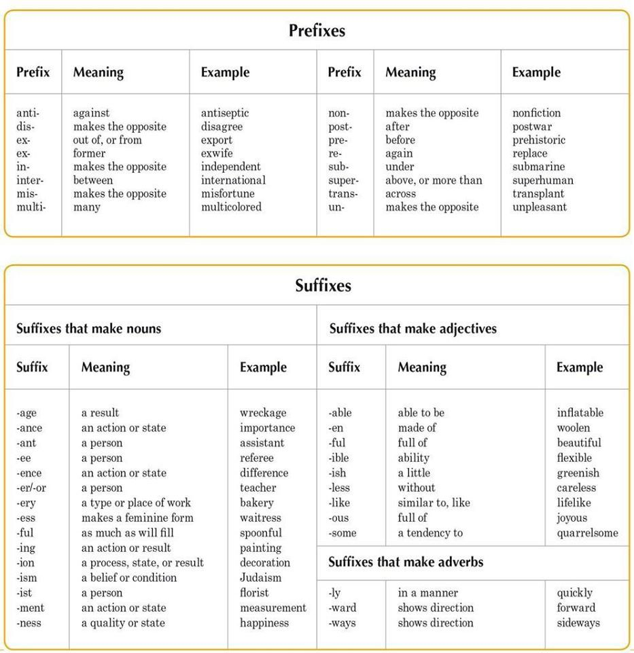

Slide 23
Management of information
  Competences in acquiring new knowledge reading a text
  Means to have the
    Ability to:
    use one’s multilingual repertoire in the management of information
    carry out tasks and cognitive operations in more than one language
    build more solid knowledge through multilingual sources

Slide 24
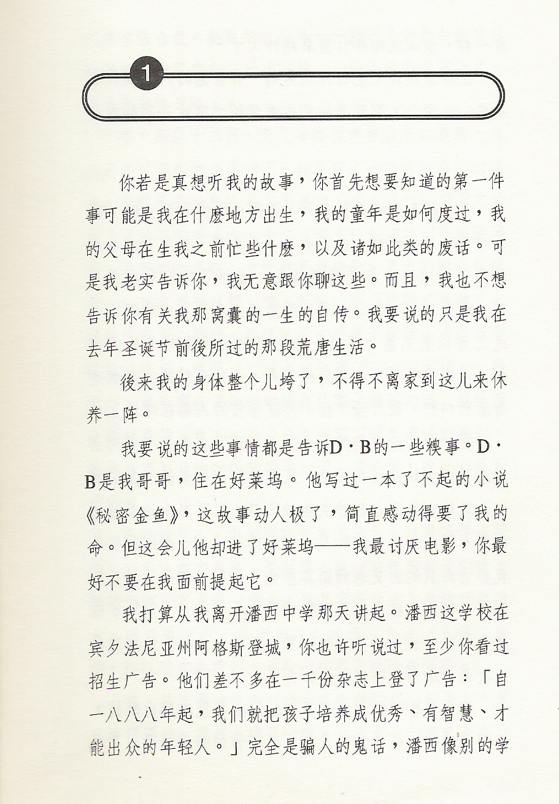

Slide 25
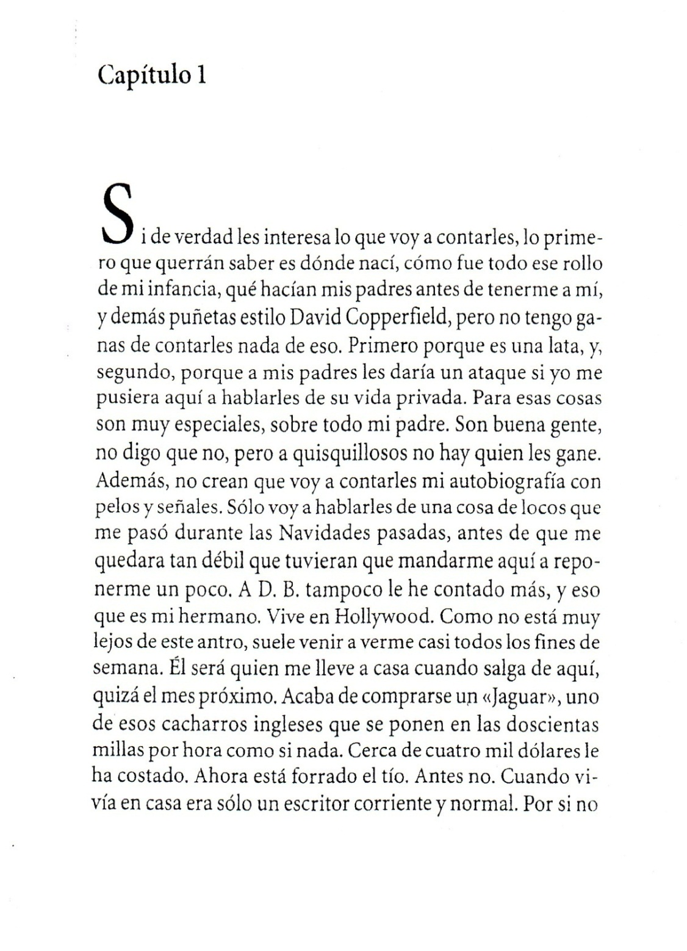

Slide 26
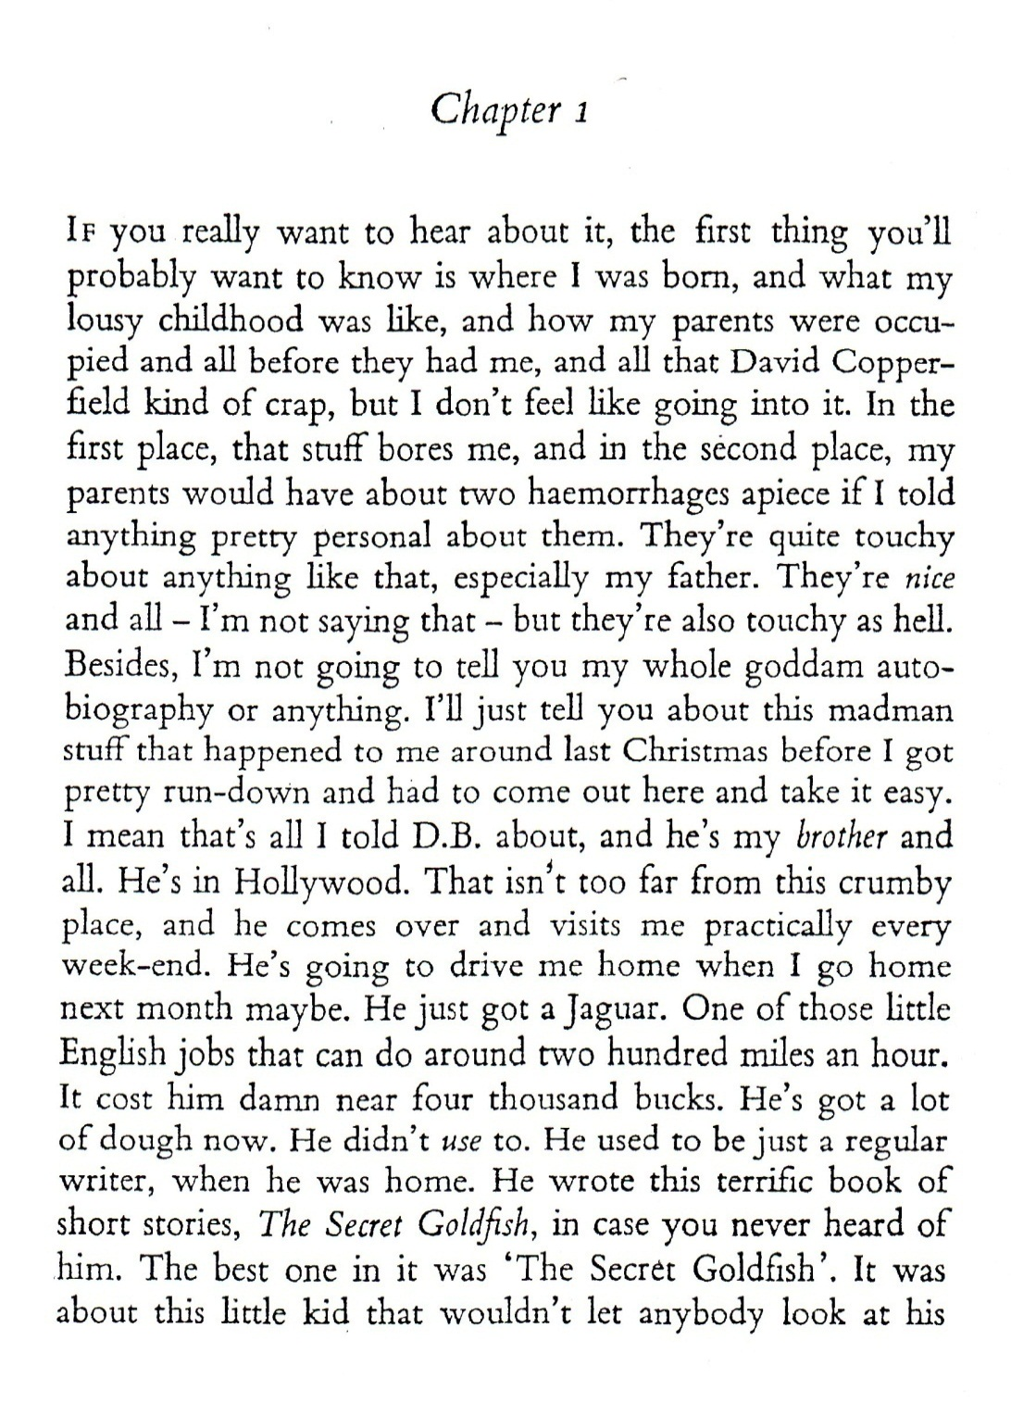

Slide 27
