Slide 1
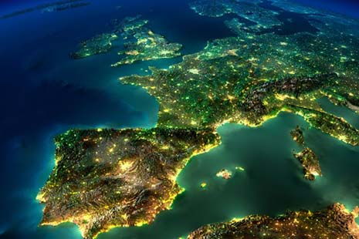
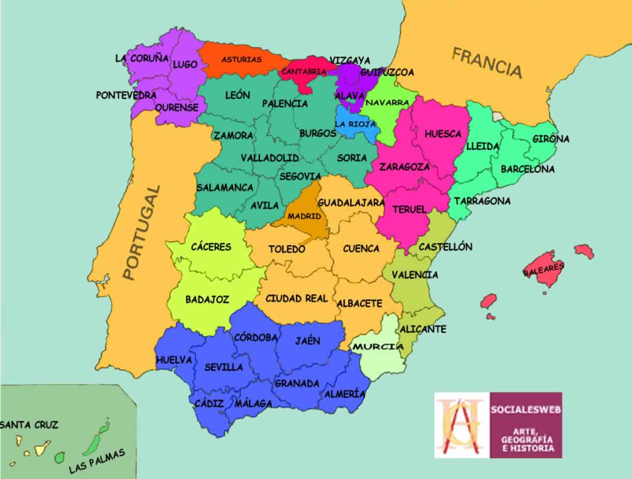

IBERIA: La península que se expandió por el mundo
HISPOLSOC 2021
Video:
https://youtu.be/p4ByC9RDPcA
Miguel López

Slide 2
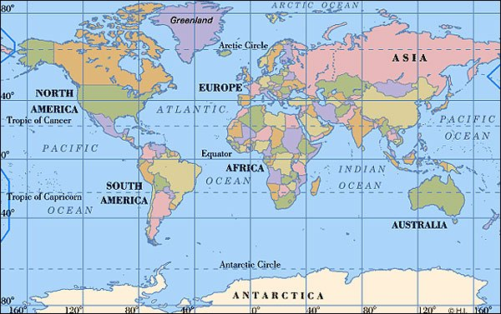

Slide 3
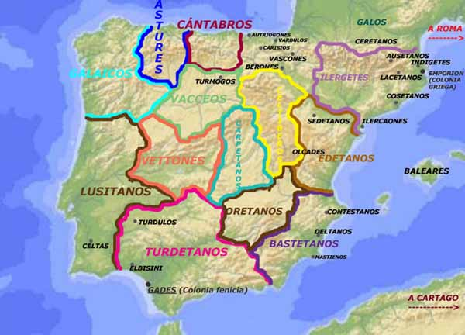

Slide 4
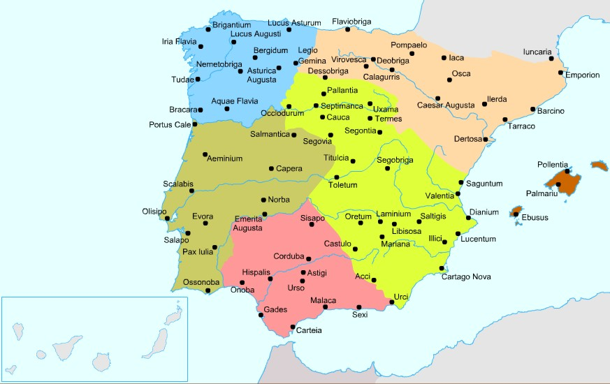

Slide 5
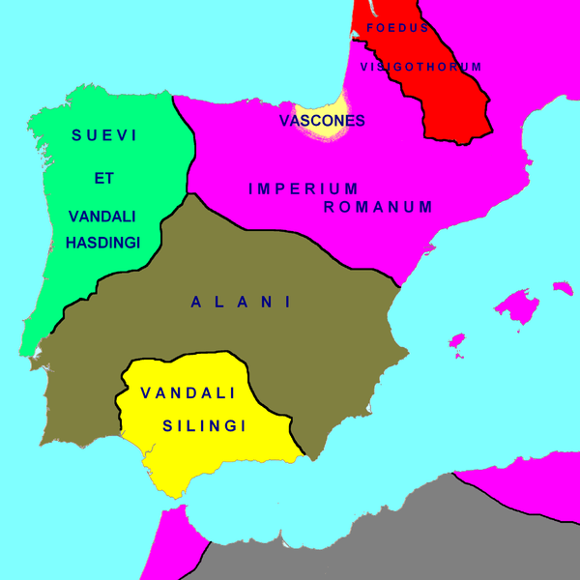

Slide 6
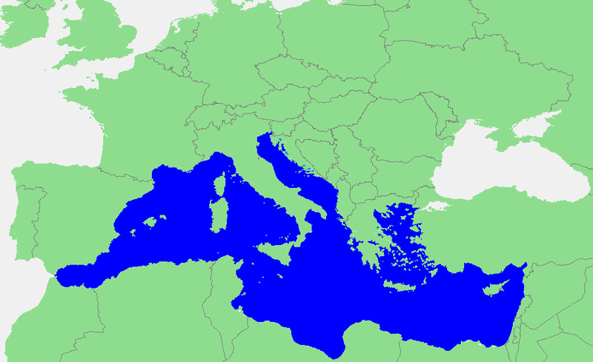
Notes:
Portugal: no mediterráneo! Alboran Sea. Mar de Alborán. Alboráninmeri on Välimeren läntisin osa.

Slide 7
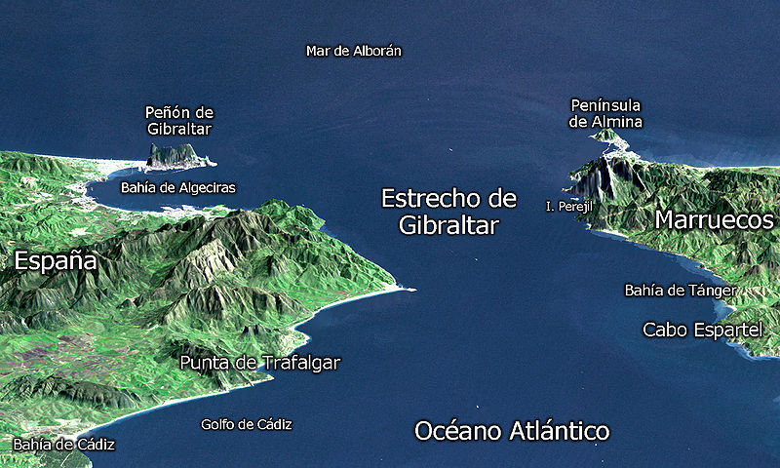

Slide 8
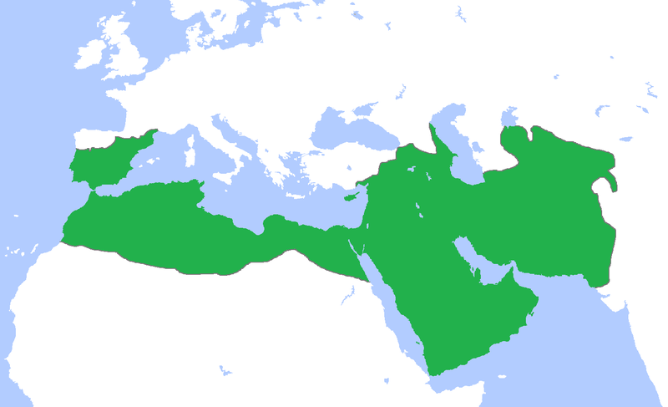
Umayyad Caliphate (Year 750)

Slide 9
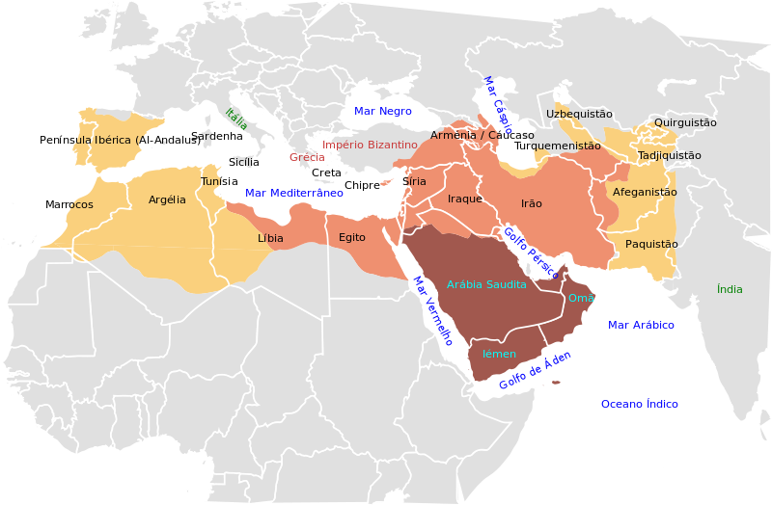

Slide 10
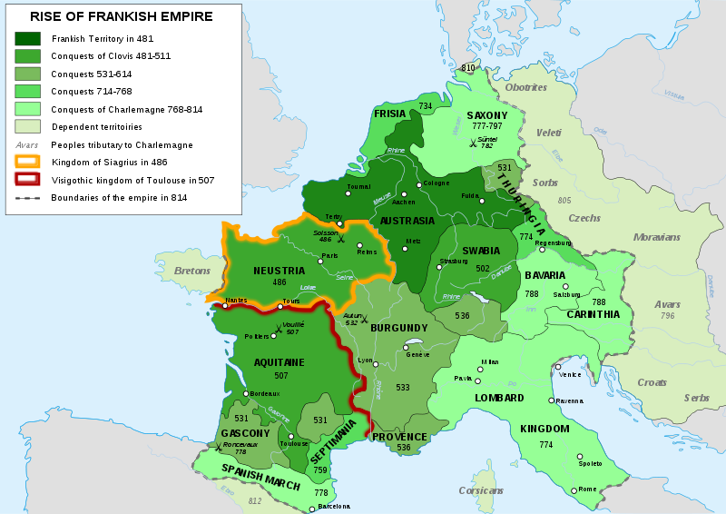
Battle of Tours Year: 732
Battle of Poitiers

Slide 11
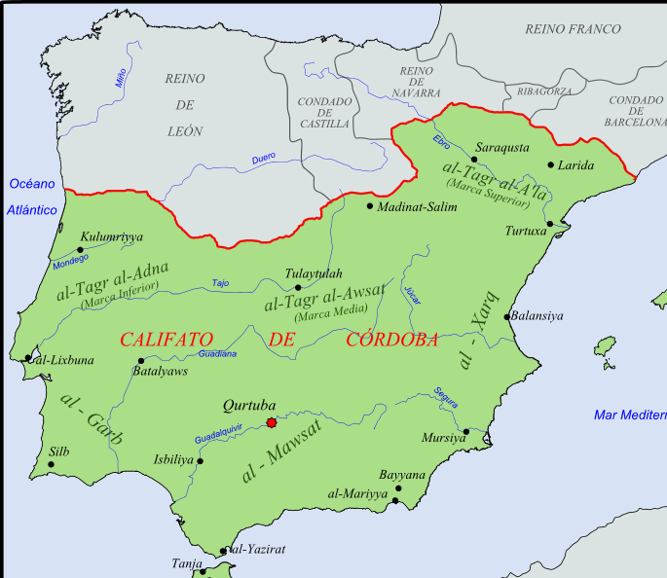
Caliphate of Córdoba Year 1000

Slide 12
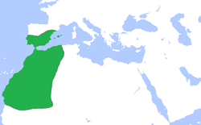
Almoravid dynasty YEAR 1100

Slide 13
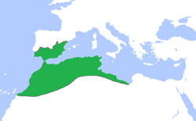
Almohad Caliphate Year 1200

Slide 14
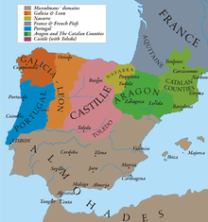
Year 1210

Slide 15
al-ʼAndalus
al-ʼGharb al-ʼAndalus (ALGARVE)
(711-1249) Ŝarq al-Andalus

Slide 16
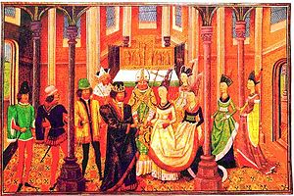
Treaty of Windsor (1386)
João I of Portugal (Aviz) & Philippa of Lancaster

Slide 17
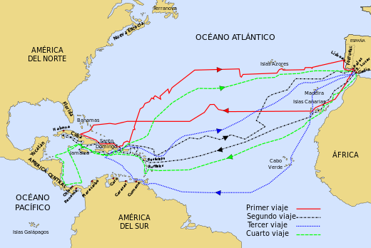

Slide 18
Treaties
Treaty of Alcáçovas 1479 Portugal: Azores, Madeira, Cape Verde
Castilla: Canary Islands
1481 Portugal: South Canary Islands ➔ Africa
Inter caetera 1493 Pope Alexander VI
Treaty of Tordesillas 1494 World: Western part exclusive to Spain and the east part to Portugal.
Treaty of Zaragoza 1529 Asia

Slide 19
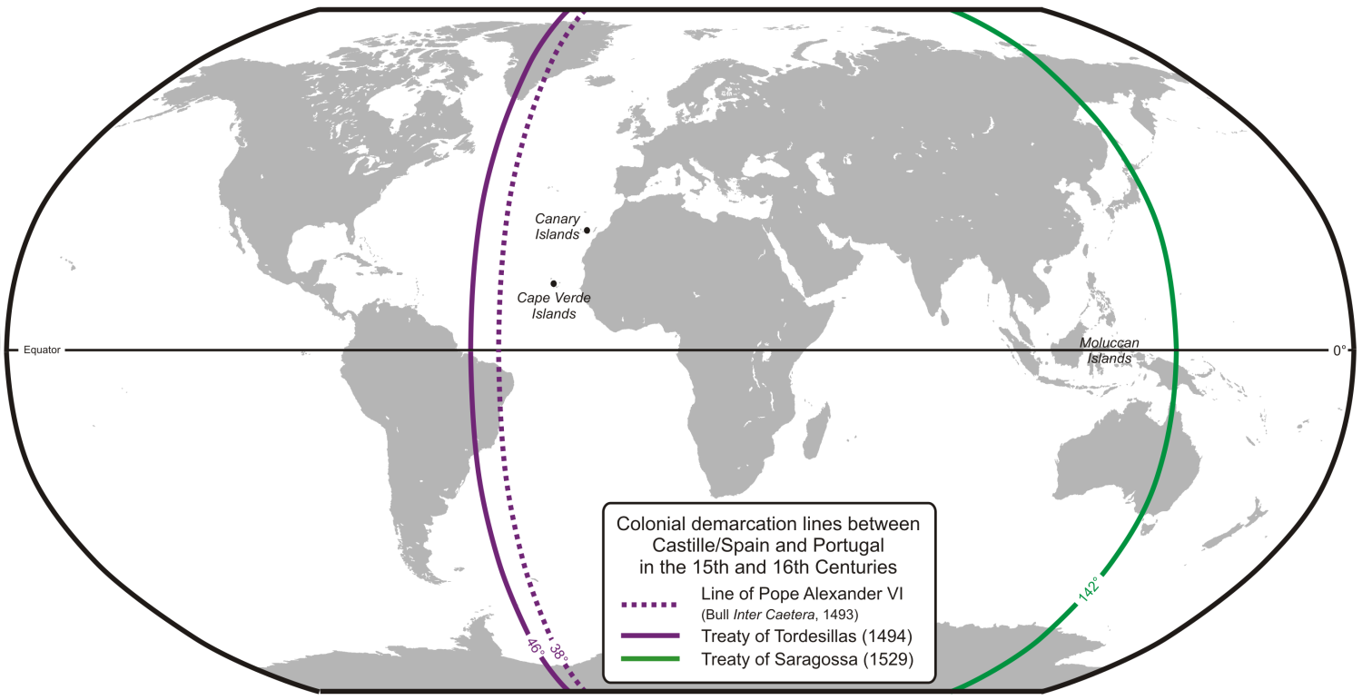
Treaty of Tordesillas

Slide 20
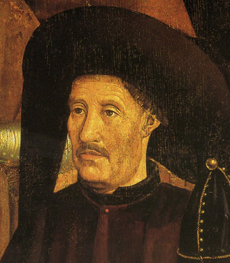
➔ Year 1580
Portugal discovered an eastern route to India (➔Cape of Good Hope)
BRAZIL
Southern Asia Trade + routes
AFRICA
CHINA and JAPAN (Religion)

Slide 21

The Iberian union from 1580–1640
Portugal and its empire ➔ decline
Metheun Treaty (1703)
Rise of Dutch and British empires - Battle of Trafalgar (1805)
Taraf al Ghar
El cabo de la cueva

Slide 22
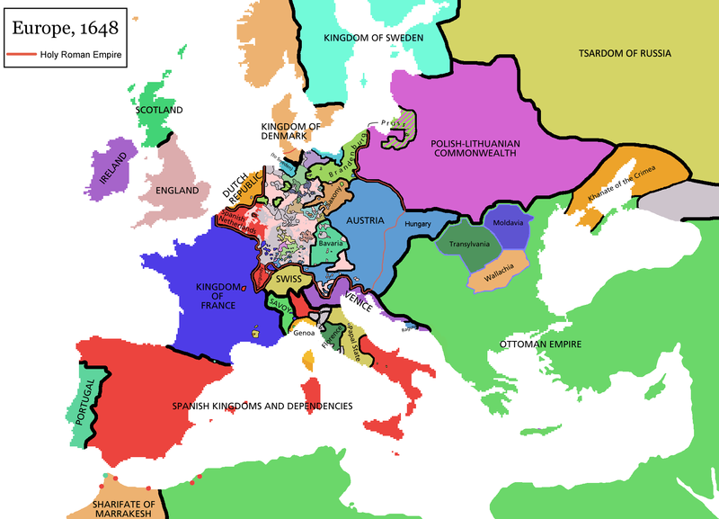

Slide 23
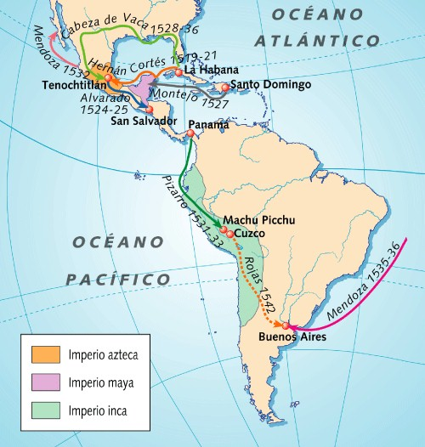

Slide 24
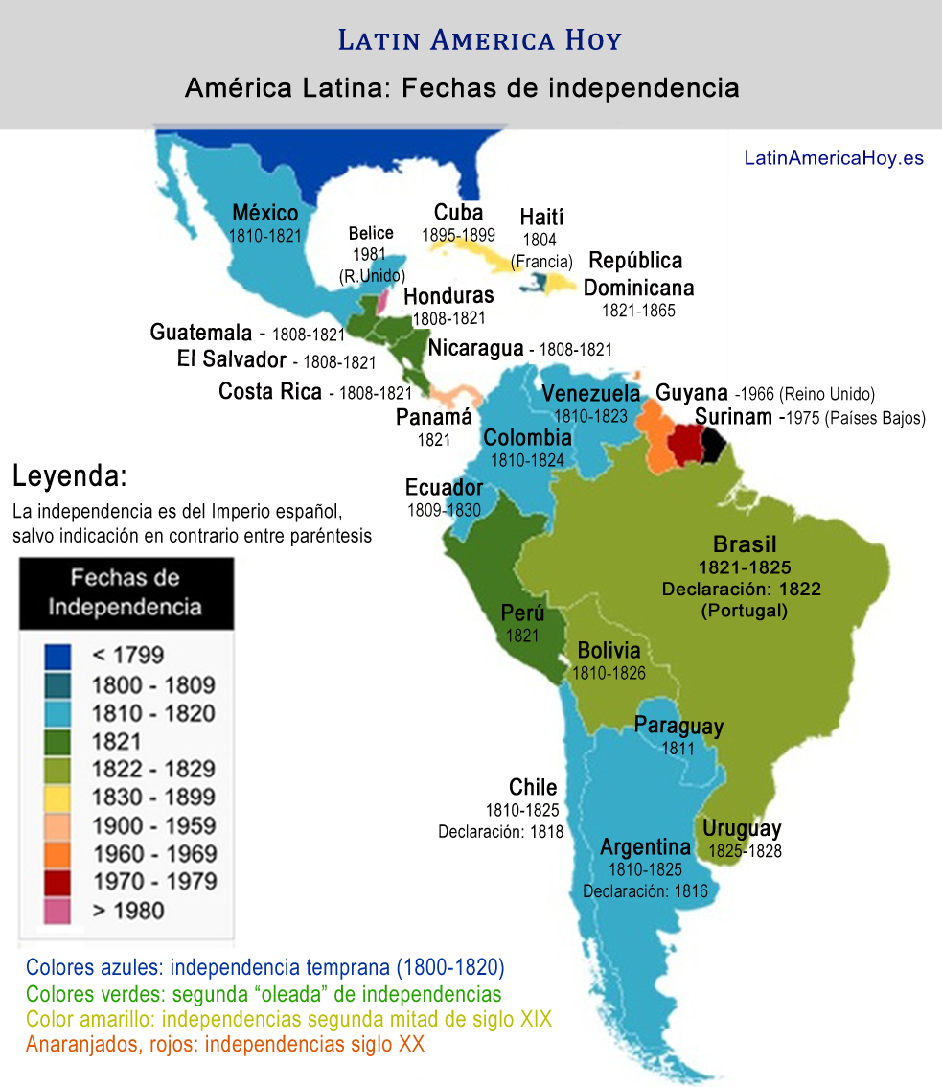

Slide 25
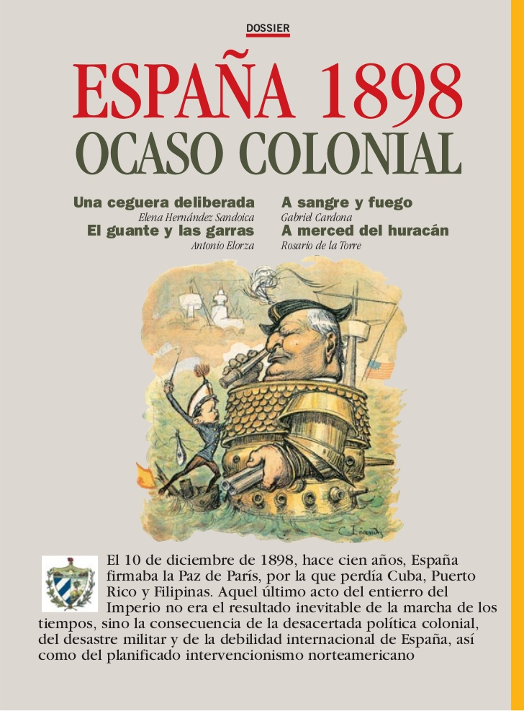
http://es.slideshare.net/parawan74/dossier-002espana1898ocasocolonialsfrd

Slide 26
