Slide 1
Acentos y Vinos
Miguel López
9.12.2019

Slide 4
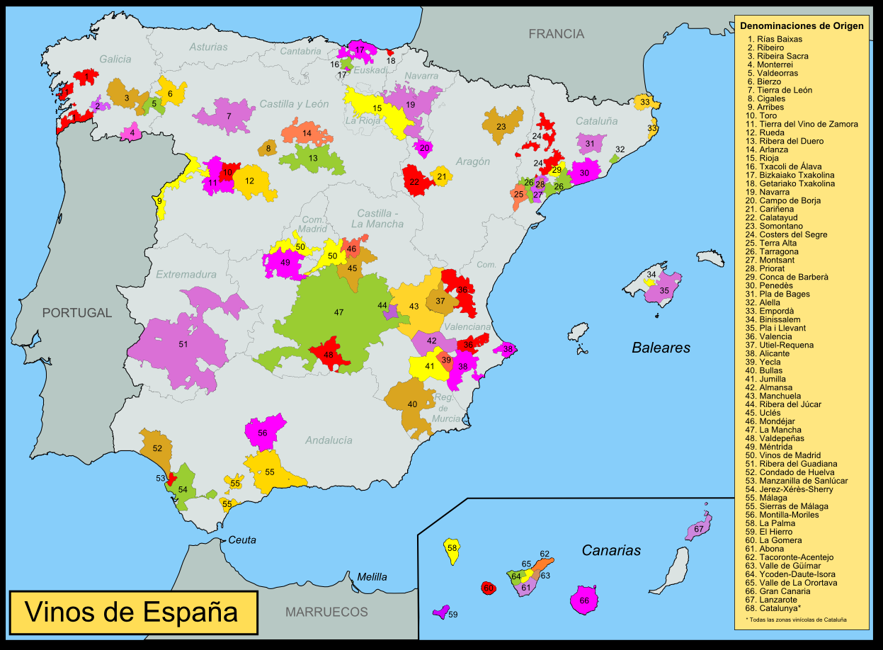

Slide 5
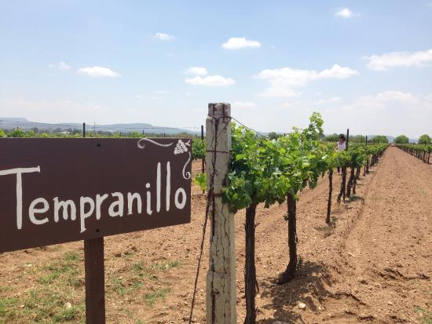
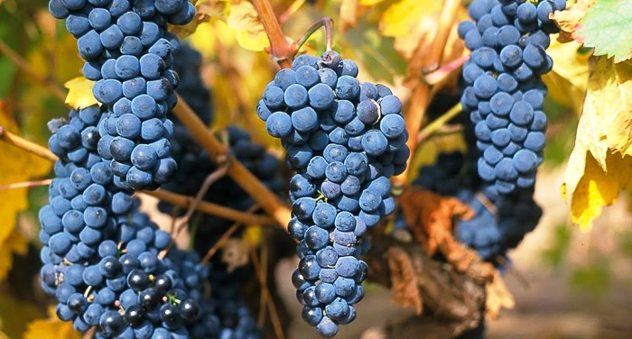
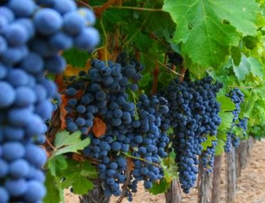

Slide 6
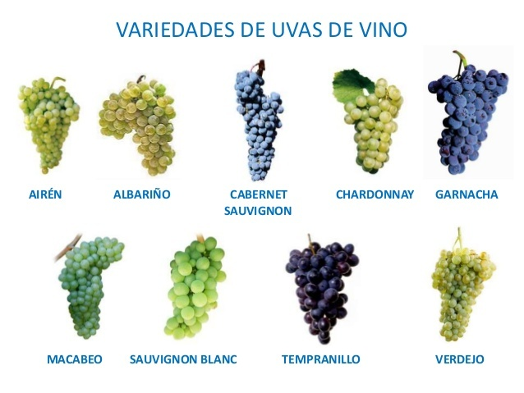

Slide 7
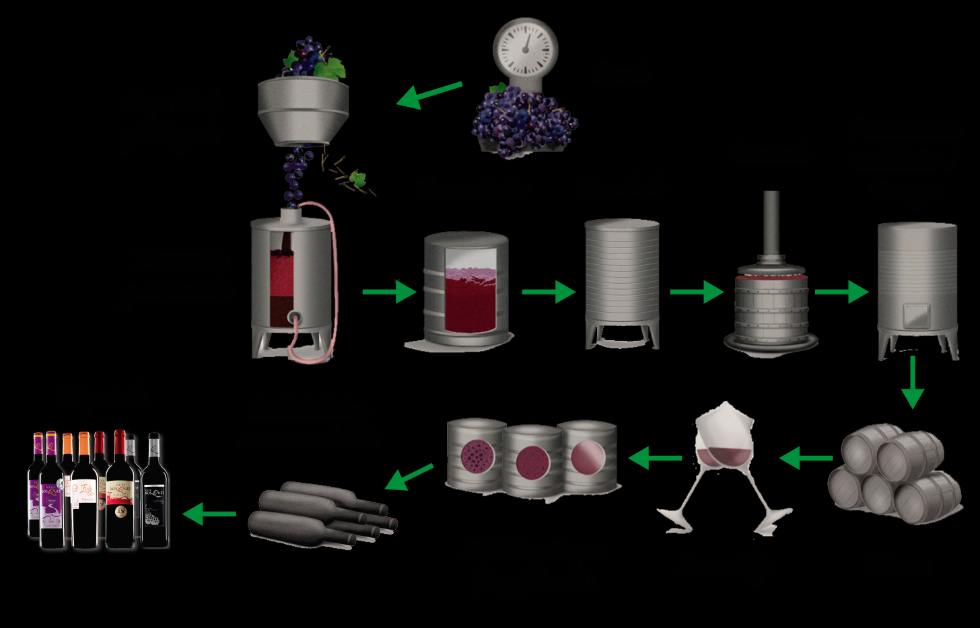

Slide 8
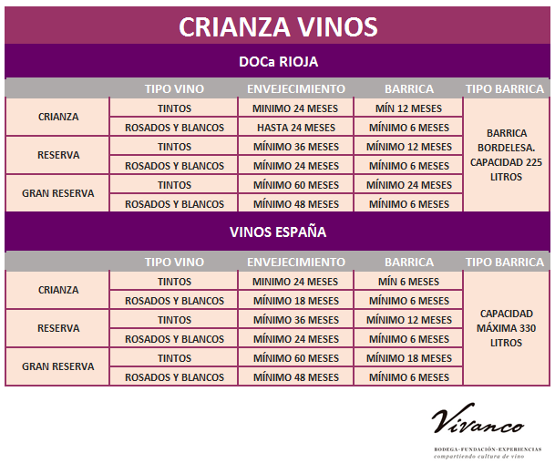

Slide 9
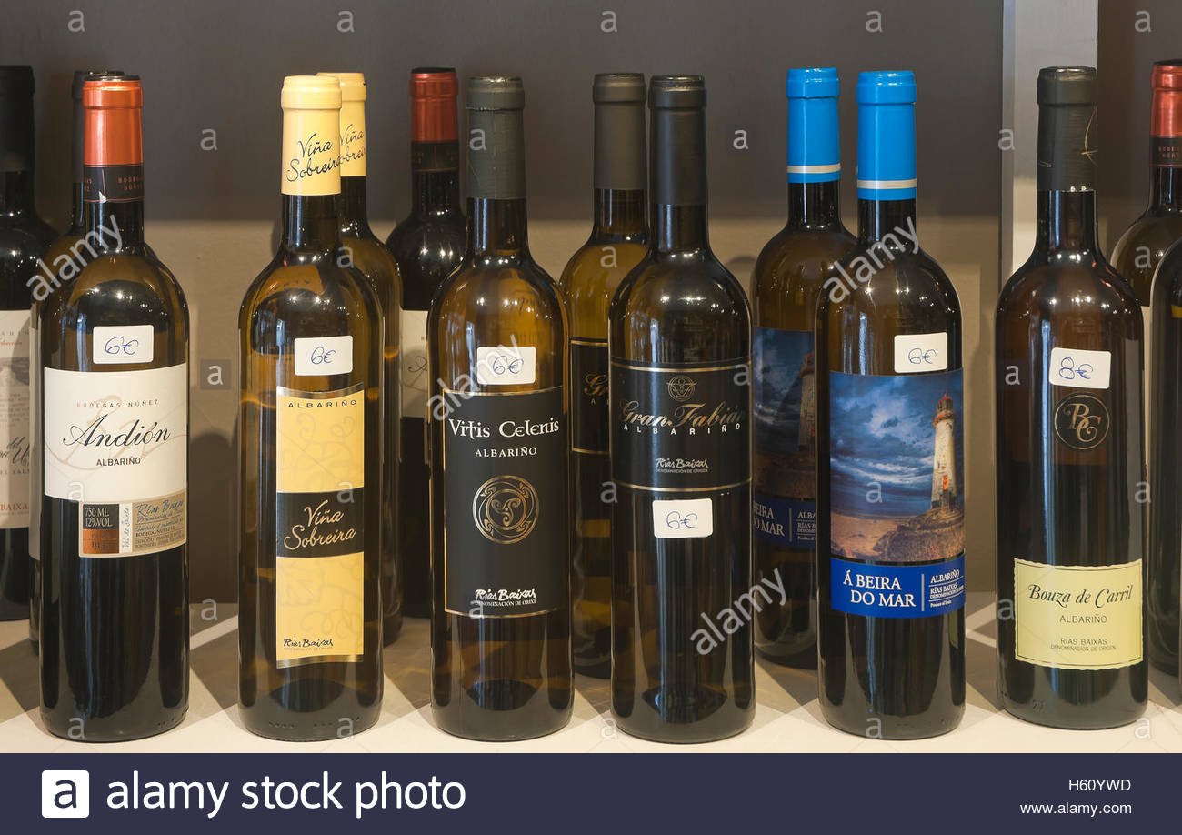

Slide 10
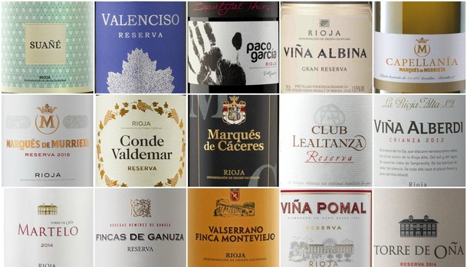

Slide 11
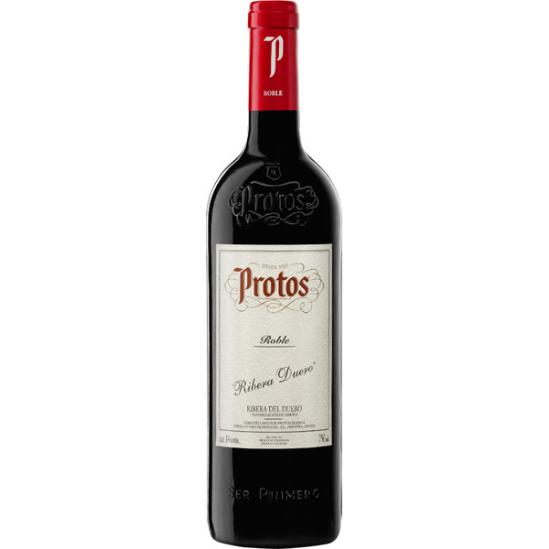
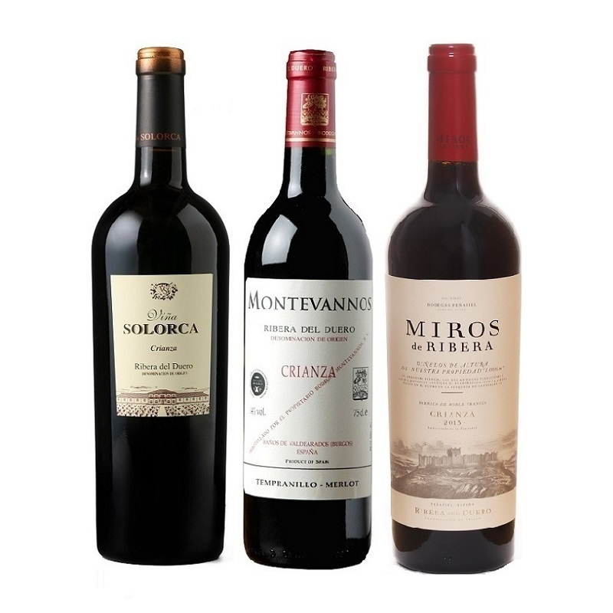

Slide 12
https://images.app.goo.gl/ThLiChjvuATuGrnk7
https://vivancoculturadevino.es/blog/2016/05/26/diferencias-entre-crianza-reserva-y-gran-reserva/
https://www.youtube.com/watch?v=M9DBz7AySLw&feature=emb_title
https://www.elespanol.com/cocinillas/recetas/bebidas/20170902/variedades-uva-tinta-mayor-presencia-espana/1000974952496_30.html
http://susysanchezsommelier.blogspot.com/2015_05_07_archive.html

Slide 13
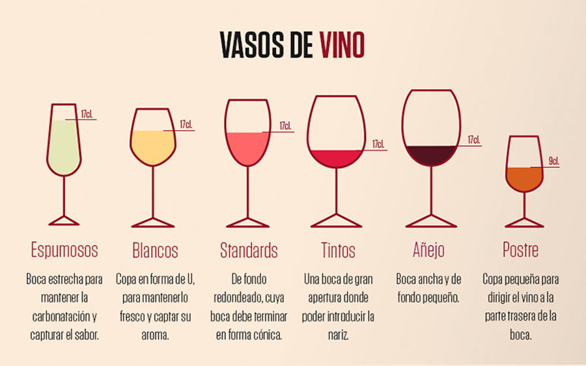

Slide 14
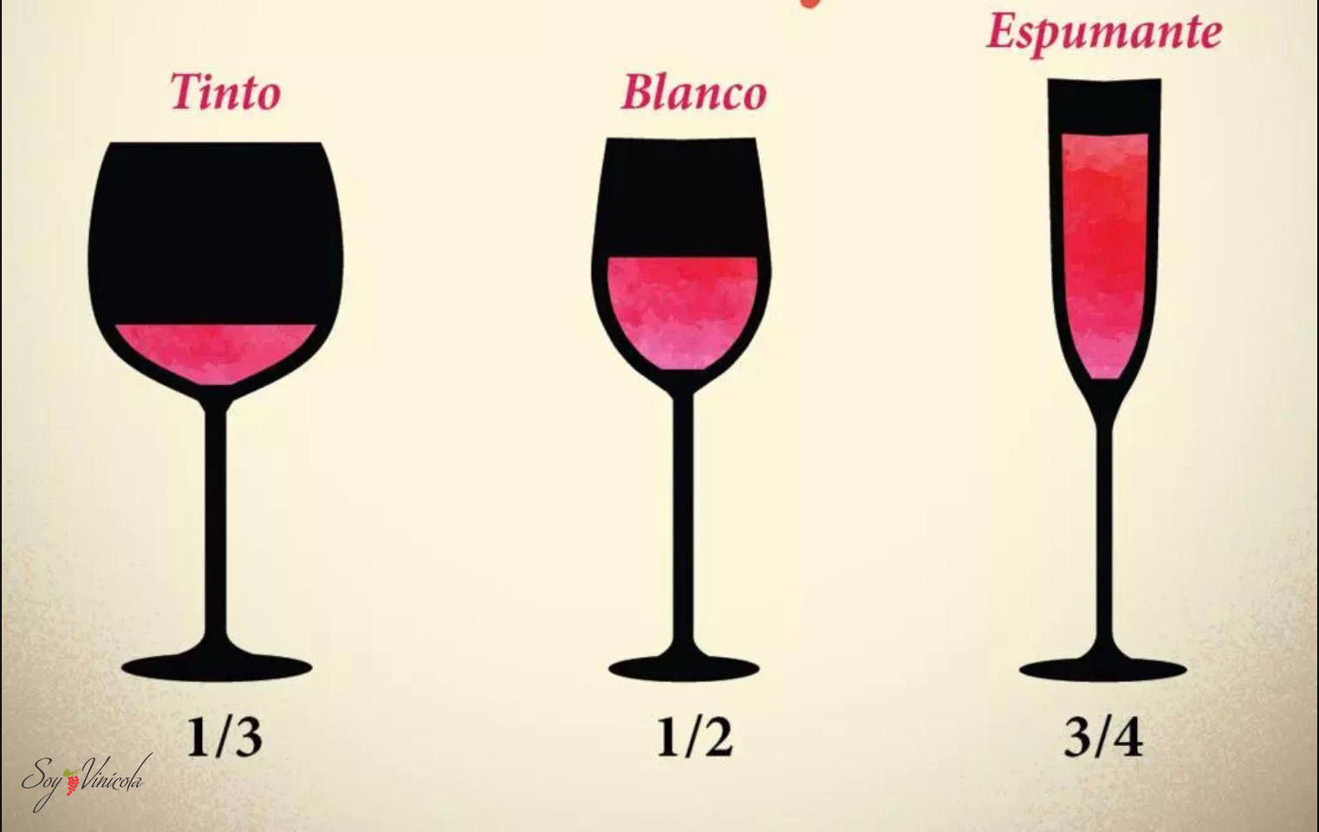

Slide 15
https://www.youtube.com/watch?v=M9DBz7AySLw&feature=emb_title
Summer Drinks Recipe: Kalimotxo, a 'Poor Man's Sangria' | The New York Times

