Slide 1

https://youtu.be/uu7EQ3MeTfI

Slide 2
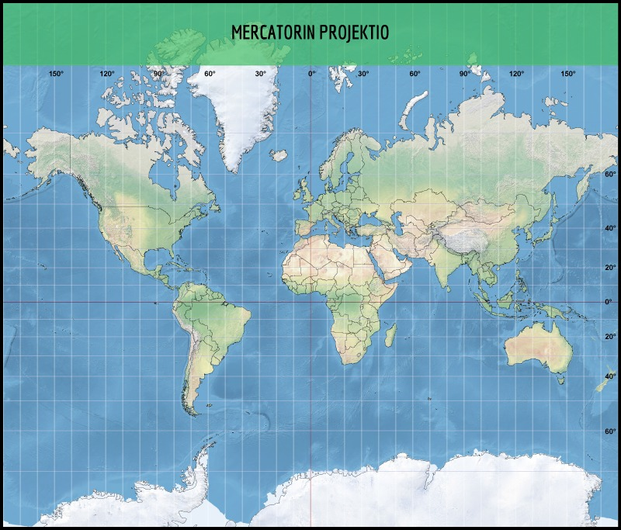

Slide 3
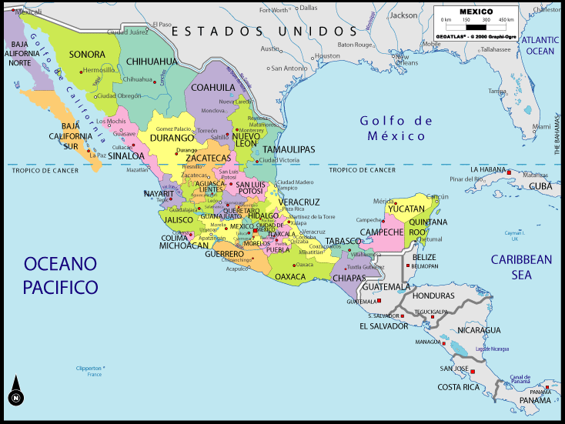

Slide 4
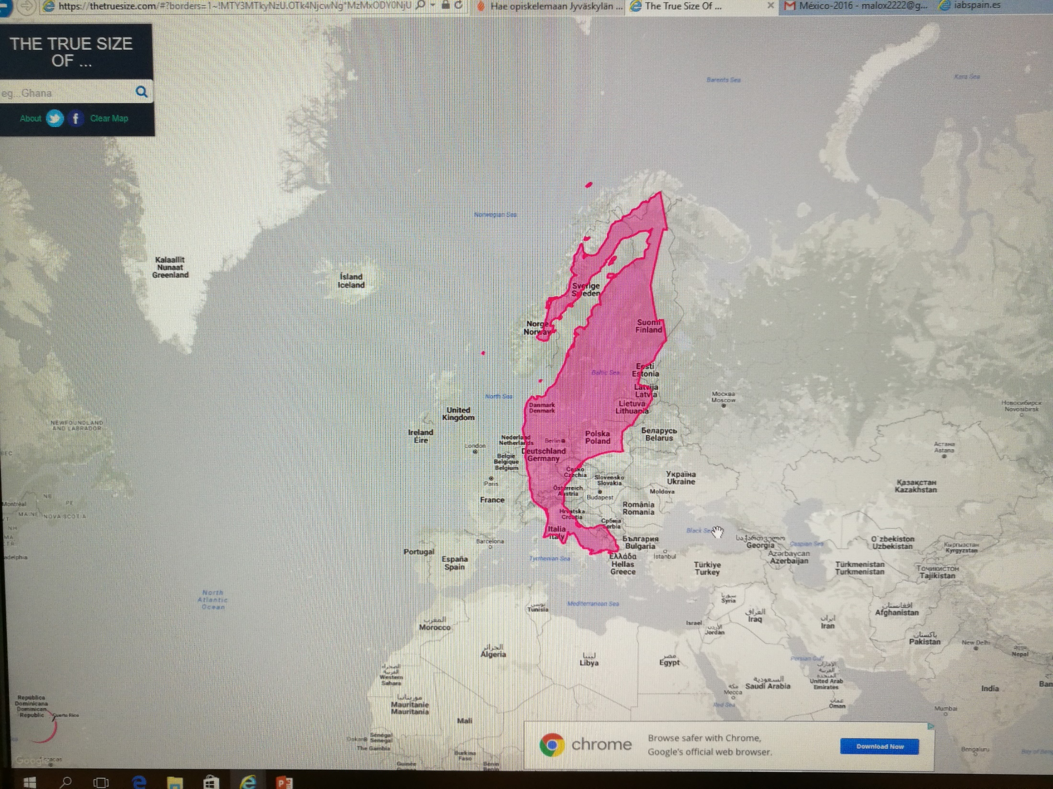

Slide 5
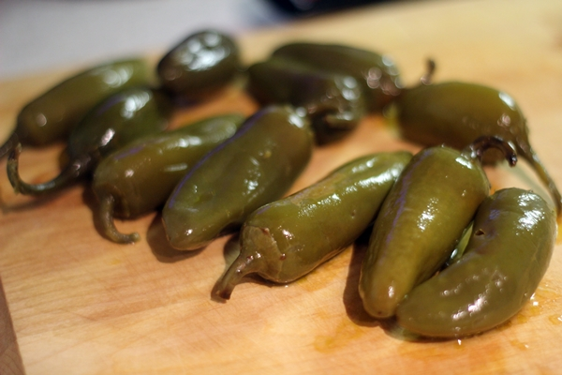
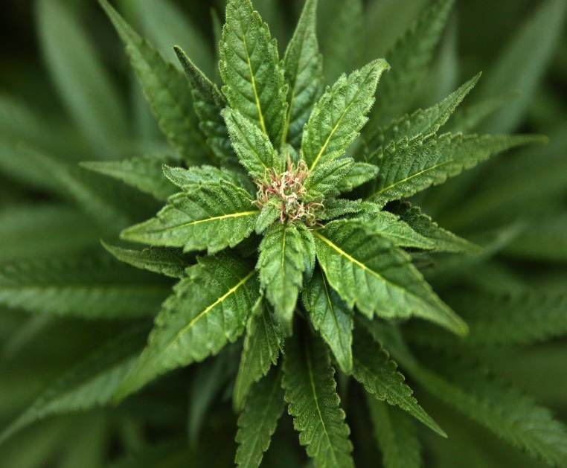
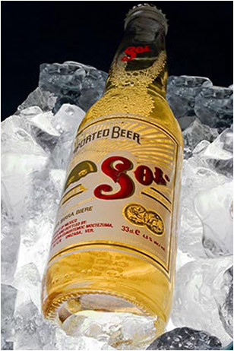



Slide 6
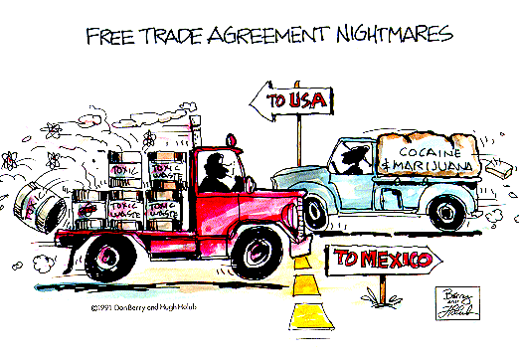

Slide 7
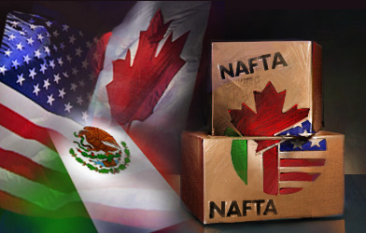
North American Free Trade Agreement

Slide 8
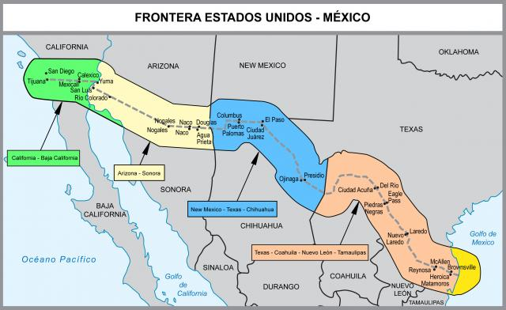

Slide 9
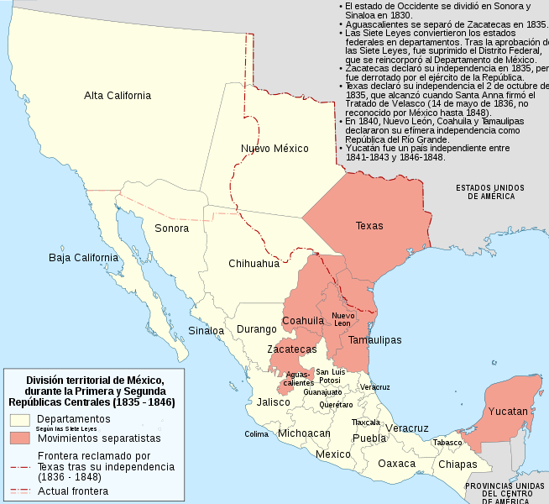

Slide 10
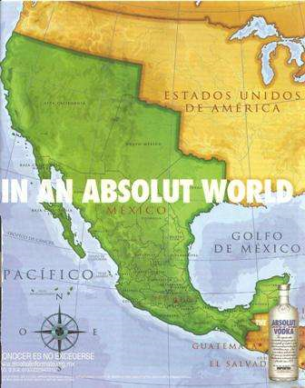

Slide 11

MÉXICO: POLÍTICA Y ECONOMÍA
https://santandertrade.com/es/portal/analizar-mercados/mexico/politica-y-economia
CIFRAS DEL COMERCIO EXTERIOR EN MÉXICO
https://es.portal.santandertrade.com/analizar-mercados/mexico/cifras-comercio-exterior

Slide 12

Embajadas, etc
https://www.facebook.com/embfinlandia/
https://twitter.com/embfinmexico
http://www.finlandia.org.mx/public/Default.aspx?culture=fi-FI&contentlan=1

Slide 13
Un diario
https://www.informador.mx/seccion/economia/
Caso: Industria automotriz
http://www.il-latam.com/blog/articulos-centrales/pulso-de-la-industria-automotriz-en-mexico
Cerveza
http://www.worldstopexports.com/beer-exports-by-country/

Slide 14


Slide 15
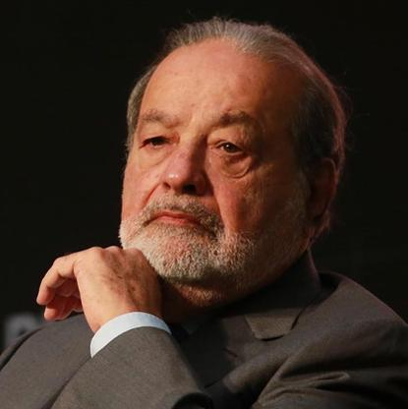
Carlos Slim Helu & family
Honorary Chairman, América Móvil
$67.4 B
Mexico's richest man, Carlos Slim and his family control America Movil, Latin America's
biggest mobile telecom firm.
With foreign telecom partners, Slim bought a stake in Telmex, Mexico's only phone company, in 1990.
He also owns stakes in Mexican construction, consumer goods, mining and real estate companies
and 17% of The New York Times.
https://www.forbes.com/profile/carlos-slim-helu/
https://www.entrepreneur.com/article/334005

Slide 16

https://www.businessinsider.com/the-21-best-absolut-ads-2013-12?r=US&IR=T
https://www.referralcandy.com/blog/absolut-vodka-marketing-strategy/

