Slide 1
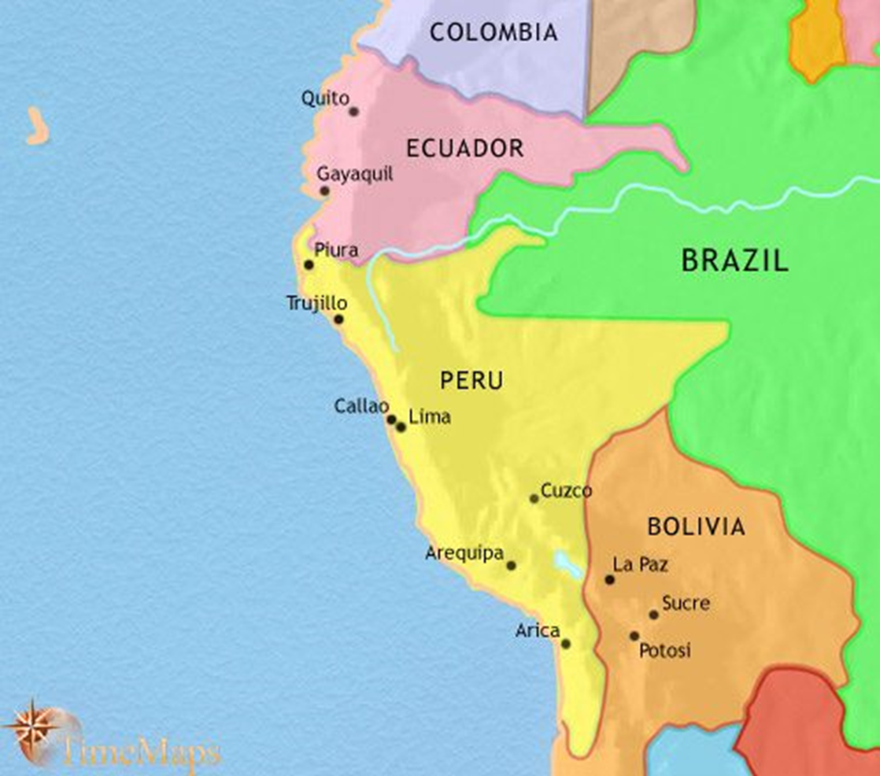
LOS PAÍSES ANDINOS: Perú
López 2021

Slide 2
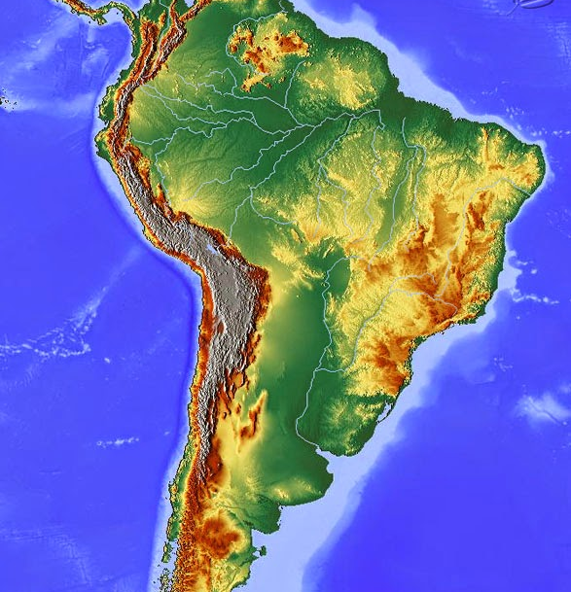
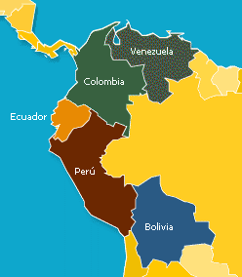

Slide 3


Slide 4
Política
https://en.wikipedia.org/wiki/2017%E2%80%932021_Peruvian_political_crisis
https://en.wikipedia.org/wiki/President_of_Peru
Ver: Living former Presidents of Peru
https://en.wikipedia.org/wiki/President_of_Peru
Escuchar en casa:
https://www.youtube.com/watch?v=75KqGPt-6ZU

Slide 5

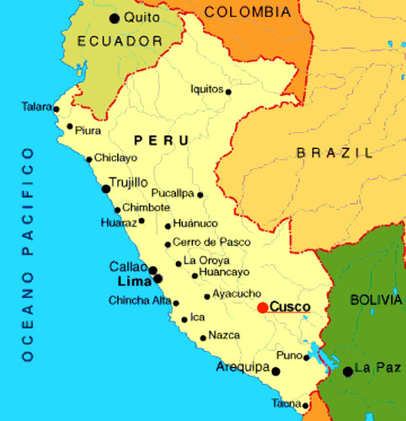
https://santandertrade.com/es/portal/analizar-mercados/peru/cifras-del-comercio

Slide 6


https://fi.wikipedia.org/wiki/Aasian_ja_Tyynenmeren_maiden_talousj%C3%A4rjest%C3%B6

Slide 7
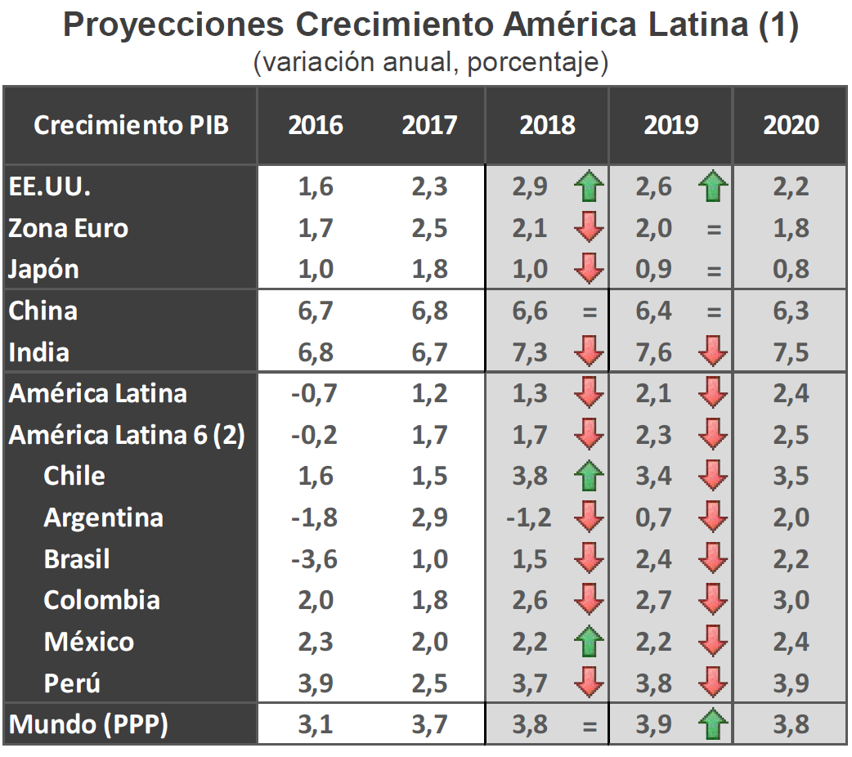
https://www.latercera.com/pulso/noticia/chile-sera-la-economia-mejor-desempeno-este-ano-america-latina-peru-la-superara-2019/348558/
➔ VOCABULARIO

Slide 8
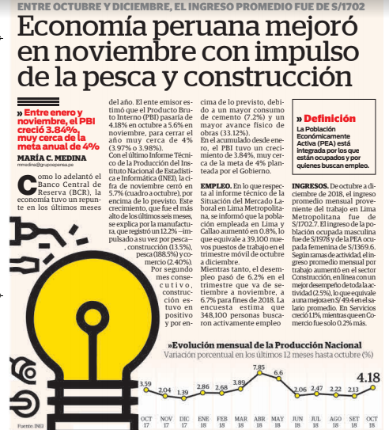

Slide 9
https://datosmacro.expansion.com/paises/peru
PERCEPCIÓN ECONÓMICA
https://www.youtube.com/watch?v=RTTkFGRhbeo
MINISTRA ANTONIETA ALVA
https://www.youtube.com/watch?v=8yL1BOVgxAA

Slide 10

https://kauppapolitiikka.fi/category/kauppapolitiikka/

