Slide 1
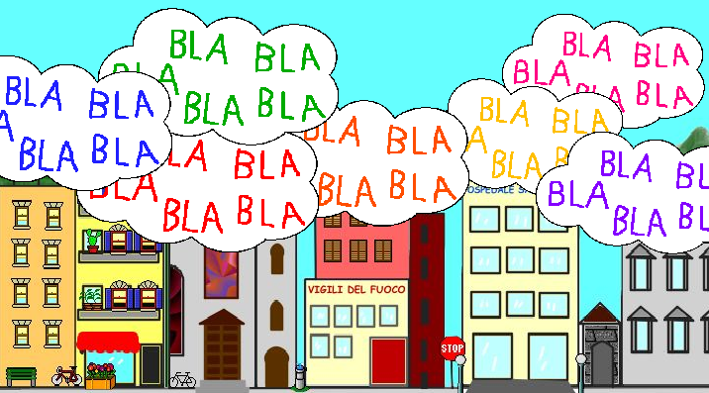

América Latina: Negociaciones, Comunicación y Cultura
Miguel López - 2019
Visión general (9.9)
México (10.9)

Slide 2

Aquí estamos:
Notes:
Negociadores

Slide 3

Estar bien documentado, informado. Conocer la propia empresa, la otra. El país, la cultura.
Notes:
Estar bien documentado, informado. Conocer la propia empresa, la otra. El país, la cultura.

Slide 4
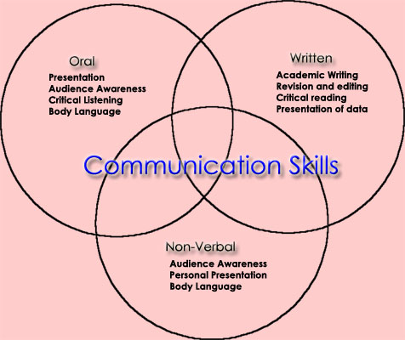

Slide 5
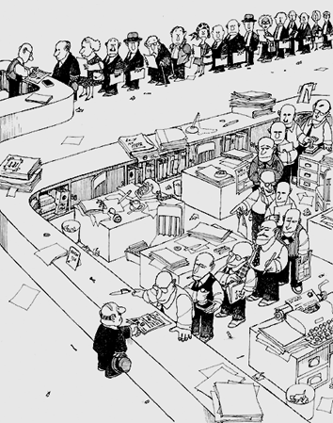
Burocracia
Notes:
Caos, burocracia

Slide 6
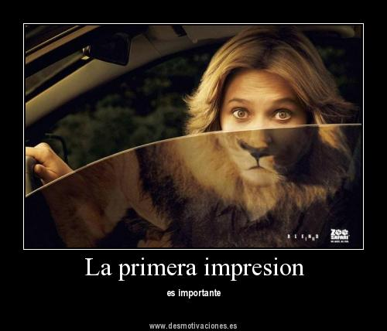

Slide 7

Paciencia, tiempo al tiempo.
Crear relaciones de amistad y confianza
Notes:
Paciencia, tiempo al tiempo. Crear relaciones de amistad y confianza

Slide 8
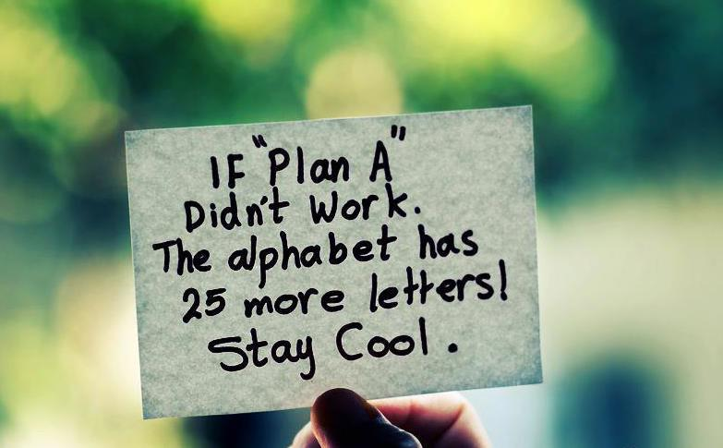
Notes:
Paciencia. Planificar.

Slide 9
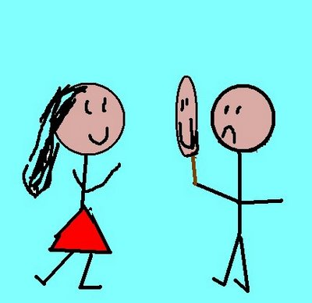
Ellos actúan
Notes:
Ellos actúan.

Slide 10

Tener opiniones. Preguntar. Partcicipar
Notes:
Tener opiniones. Preguntar. Partcicipar

Slide 11
NEGOTIATIONS & MANAGEMENT
Respect and courtesy
Tolerance
Identify problems
Cultural taboos
Know the Law
Simplify language
Be flexible ➔

Slide 12
Edward T. Hall was an anthropologist who made early discoveries of key cultural factors. In particular he is known for his high and low context cultural factors.
High context
In a high-context culture, there are many contextual elements that help people to understand the rules. As a result, much is taken for granted.
This can be very confusing for person who does not understand the 'unwritten rules' of the culture.
Low context
In a low-context culture, very little is taken for granted. Whilst this means that more explanation is needed, it also means there is less chance of misunderstanding particularly when visitors are present.

Slide 13
Openness of messages
Many covert and implicit messages, with use of metaphor and reading between the lines.
Many overt and explicit messages that are simple and clear.
Use of non-verbal communication
Much nonverbal communication and body language.
More focus on verbal communication
Cohesion and group significance
Strong distinction between ingroup and outgroup. Strong sense on family
Flexible and open grouping patterns, changes when needed.
Relationship vs task
Relationship more important than task ➔ amigo.
Task more important.
Conception of time
Open, flexible, present oriented, process more important that product. POLYCHRONIC
Linear time, well organized, product more important than process. MONOCHRONIC

Slide 14
TIME
EDWARD T. HALL
Open, flexible, present oriented, process more important that product. POLYCHRONIC
Linear time, well organized, product more important than process. MONOCHRONIC
FONS TROMPENAAR:
Time as synchronisation ➔ events in parallel, synchronised together.
Finds order in coordination of multiple factors.
Time as sequence ➔ events as separate items, sequence one after the other.
Order in actions that are one after the other.
GEERT HOFSTEDE:
Long- versus Short-term Orientation (LTO) ➔ focuses on to what extent the group invests for the future, is persevering, and is patient in waiting for results.

Slide 15
Geert Hofstede, Culture’s Consequences: Comparing Values, Behaviors, Institutions, and Organizations Across Nations. Second Edition, Thousand Oaks CA: Sage Publications, 2001
Geert Hofstede, Gert Jan Hofstede and Michael Minkov, Cultures and Organizations: Software of the Mind. Revised and Expanded 3rd Edition. McGraw-Hill 2010.
Copyright www.geert-hofstede.com
➔ https://www.hofstede-insights.com/country-comparison/

Slide 16


