Slide 1
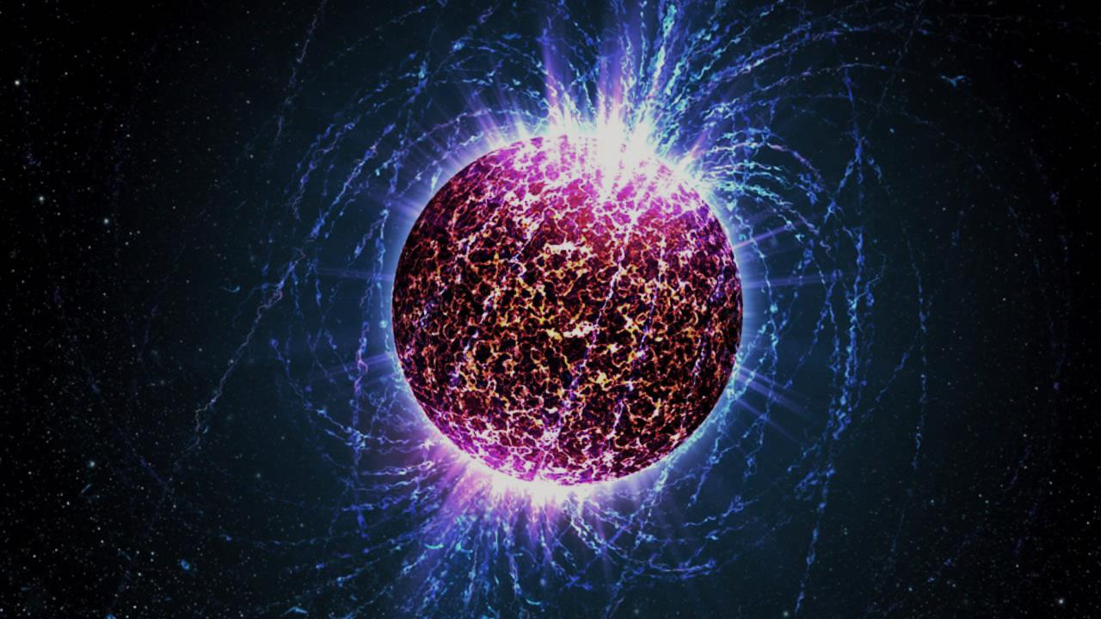
Quark matter equation of state and neutron stars Aleksi Vuorinen University of Helsinki
Particle Physics Day, University of Jyväskylä
25.11.2016

Slide 2
Background and motivation
Basics of neutron stars
Neutron star matter EoS: current state of the art
New developments in the description of quark matter
Conclusions

Slide 3
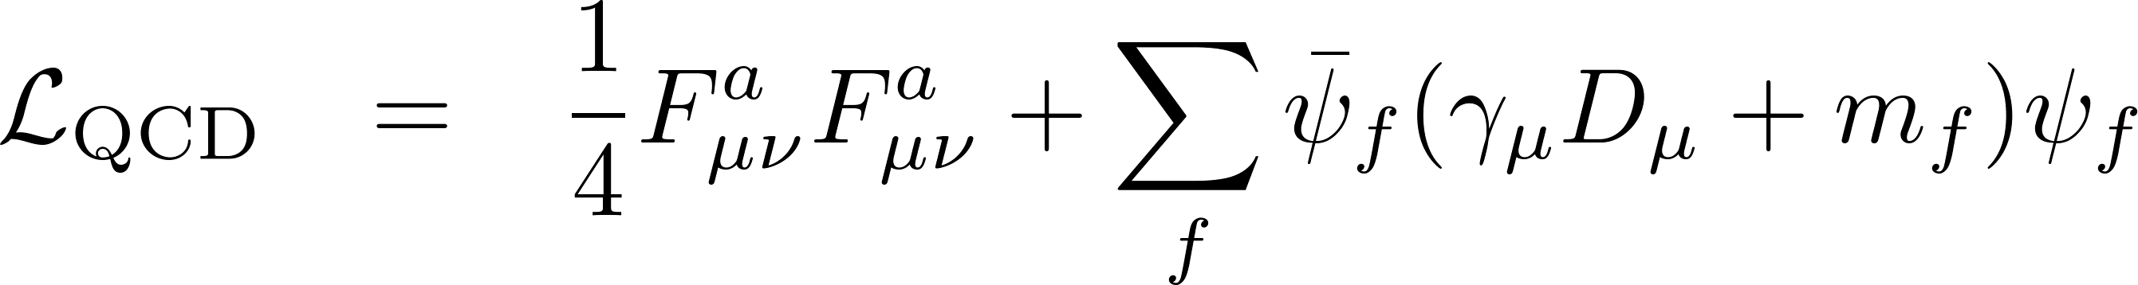
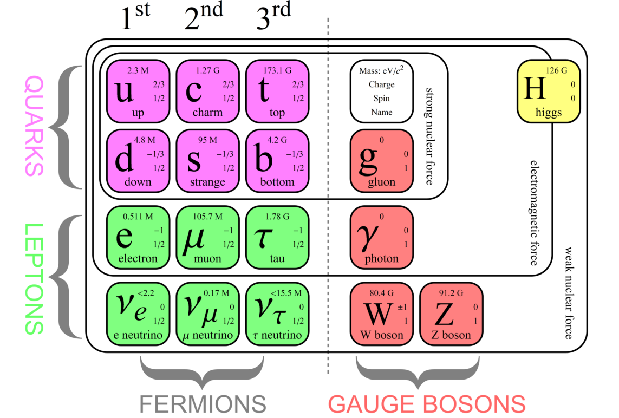
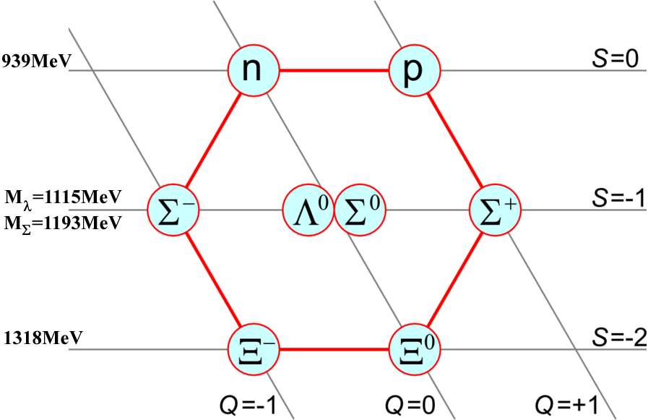

Slide 4
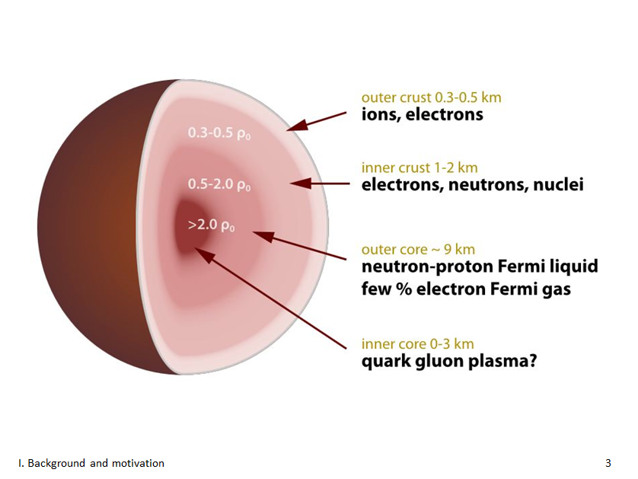
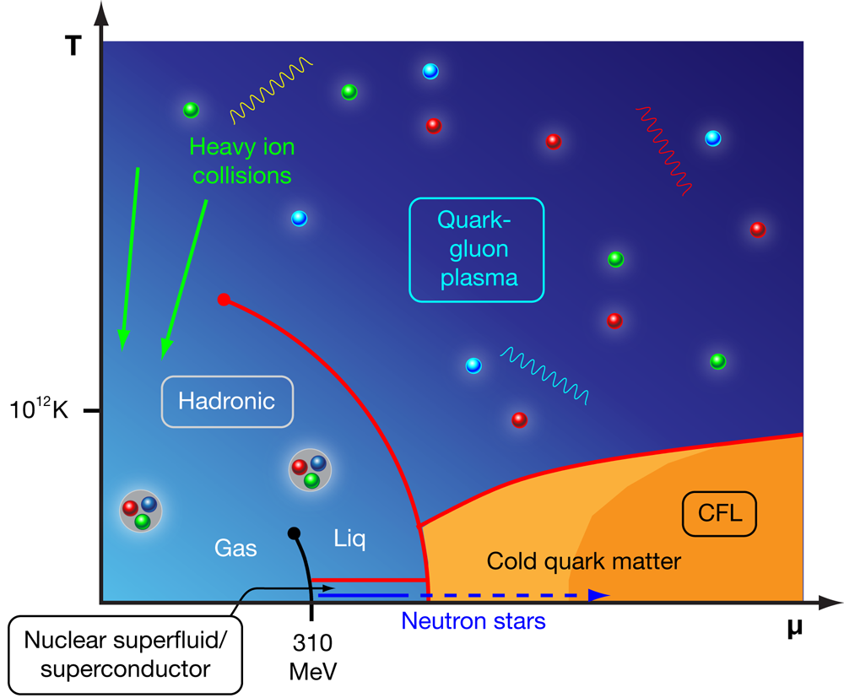

Slide 5
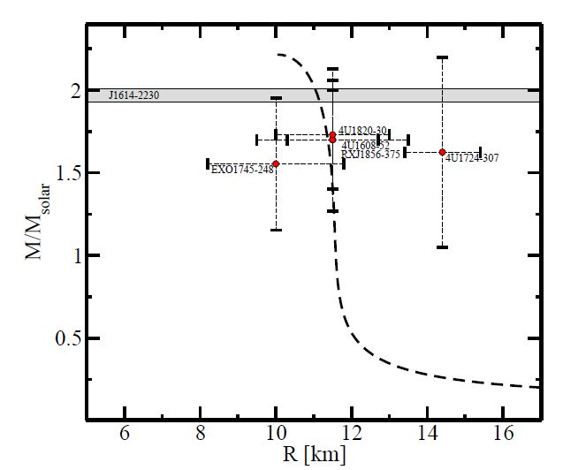
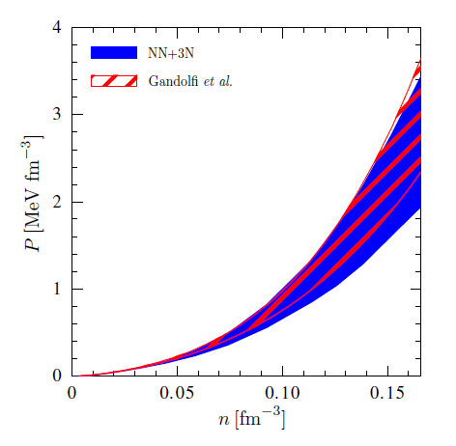
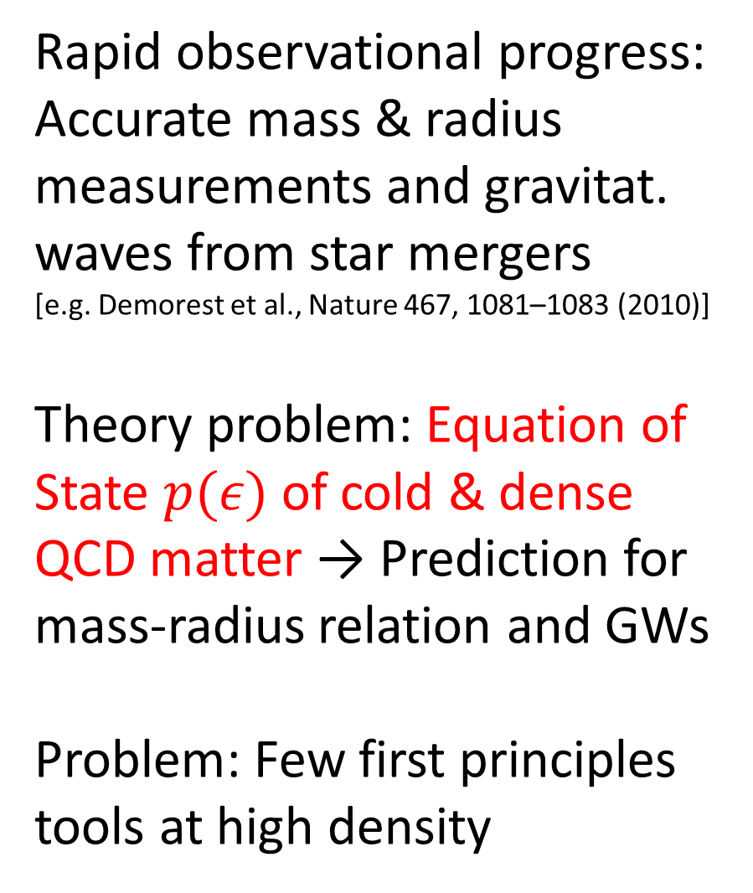
Rapid observational progress: Accurate mass & radius measurements and gravitat. waves from star mergers [e.g. Demorest et al., Nature 467, 1081–1083 (2010)]
Theory problem: Equation of State $p(ε)$ of cold & dense QCD matter → Prediction for mass-radius relation and GWs
Problem: Few first principles tools at high density

Slide 6
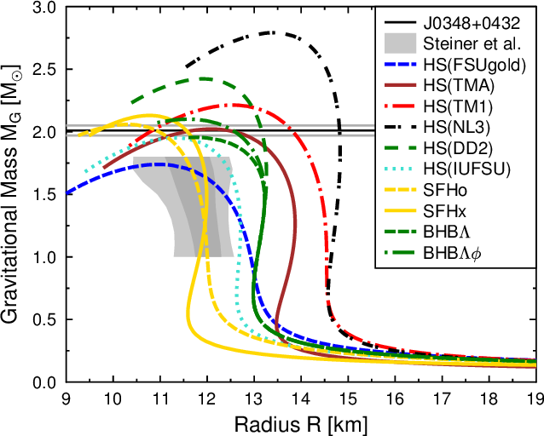
Rapid observational progress: Accurate mass & radius measurements and gravitat. waves from star mergers [e.g. Demorest et al., Nature 467, 1081–1083 (2010)]
Theory problem: Equation of State $p(ε)$ of cold & dense QCD matter → Prediction for mass-radius relation and GWs
Problem: Few first principles tools at high density

Slide 7
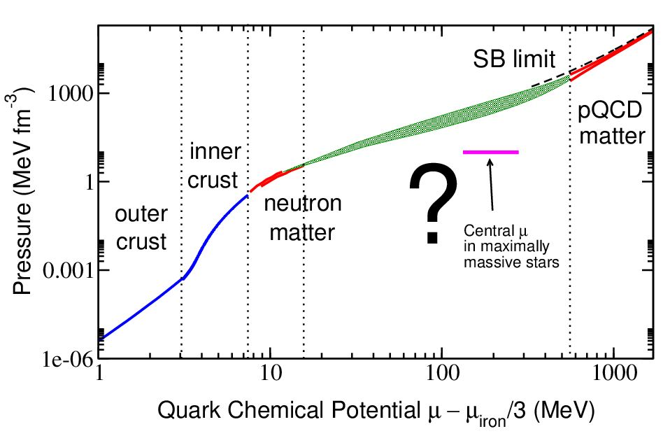
State-of-the-art of EoS: Interpolation between known results
Up to saturation density with nuclear physics methods
High density limit from perturbative QCD
Nontrivial insight: Neutron star EoS constrained by pQCD limit

Slide 8
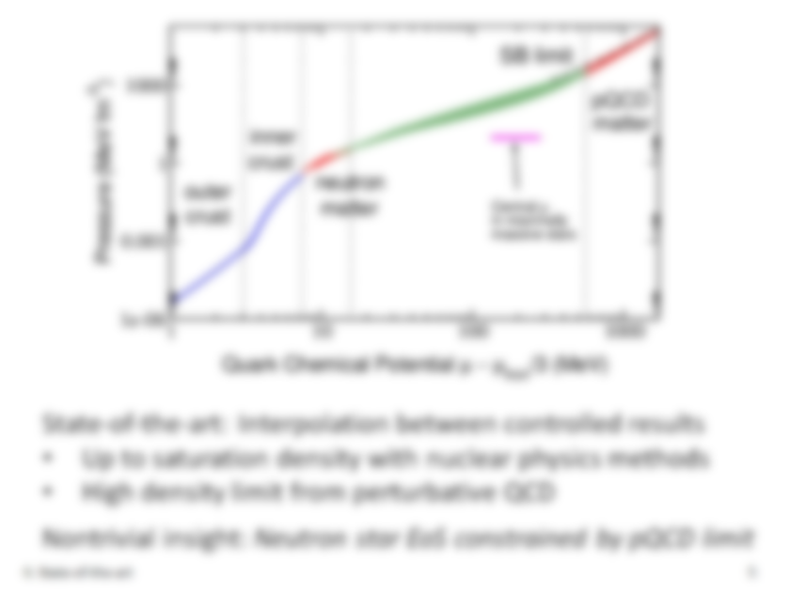
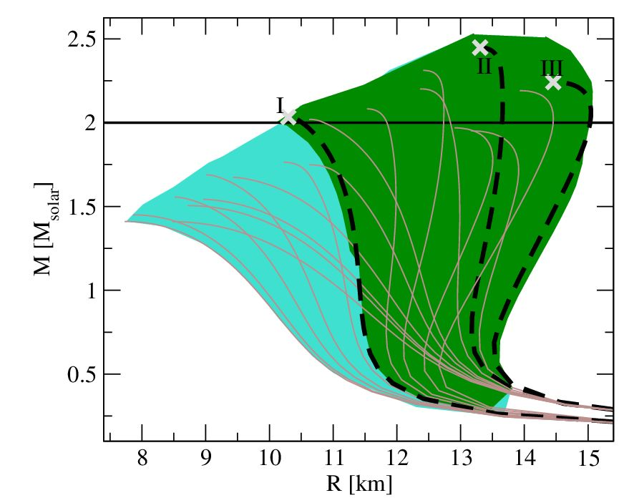

Slide 9
State-of-the-art: Interpolation between controlled results
Up to saturation density with nuclear physics methods
High density limit from perturbative QCD
Nontrivial insight: Neutron star EoS constrained by pQCD limit

Slide 10
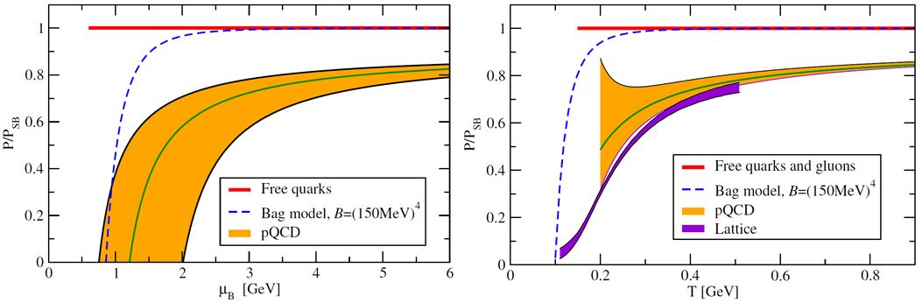
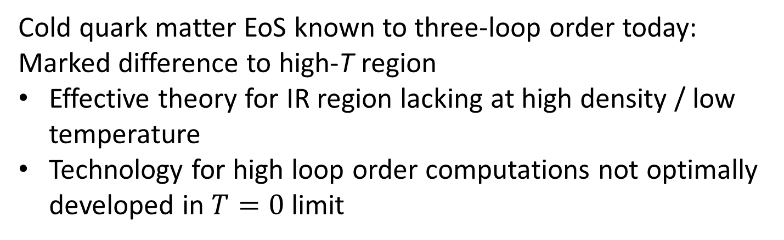
Cold quark matter EoS known to three-loop order today: Marked difference to high-T region
Effective theory for IR region lacking at high density / low temperature
Technology for high loop order computations not optimally developed in $T=0$ limit

Slide 11
Two examples of recent progress:
Extension of pQCD EoS to small but nonzero temperatures [Kurkela, AV, Phys. Rev. Lett. 117, 042501 (2016)]
Insights from holography: EoS of strongly coupled quark matter [Hoyos, Jokela, Rodriquez, AV, Phys. Rev. Lett. 117, 032501 (2016)]

Slide 12
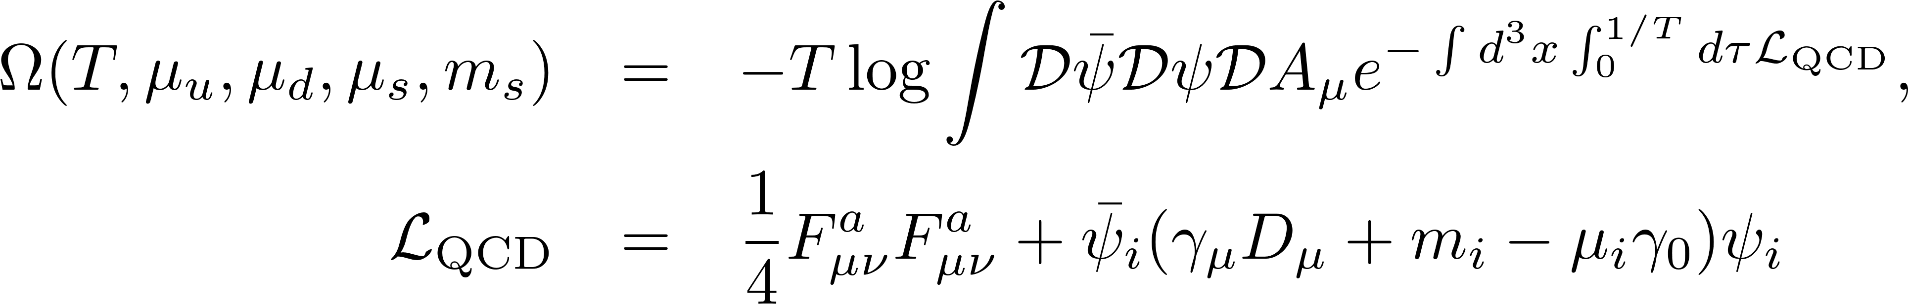
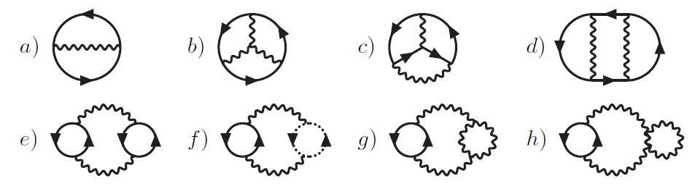
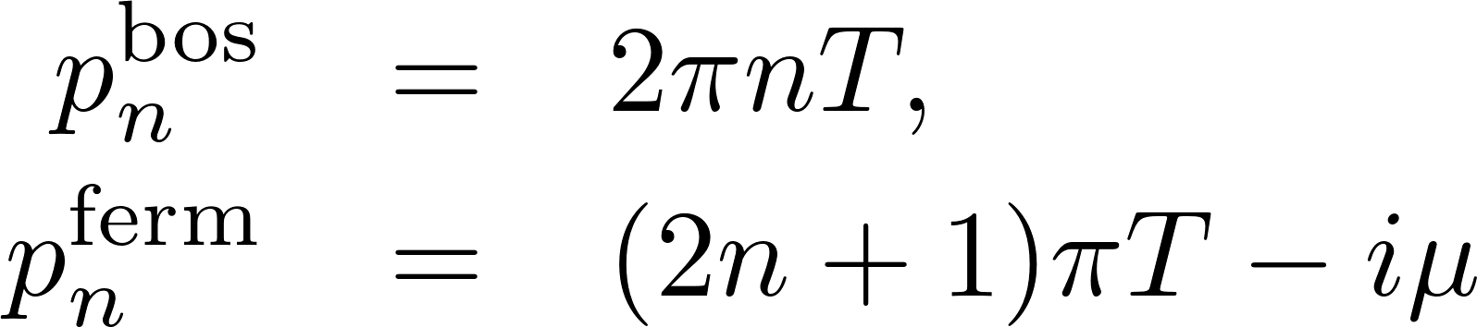
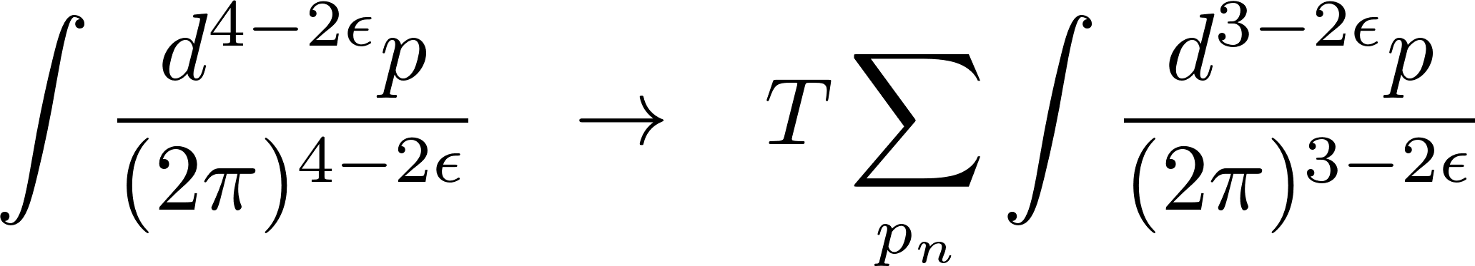
Perturbation theory: expansion of partition function in powers of gauge coupling g → Vacuum or bubble diagrams

Slide 13
Problem in pQCD: infrared divergences at three-loop order from long-range (static) gauge fields

Slide 14
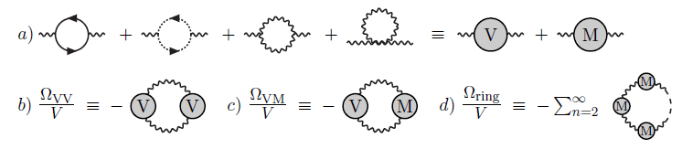
Problem in pQCD: infrared divergences at three-loop order from long-range (static) gauge fields
Solution: Resummation of IR sensitive contributions to the EoS: sum (certain) diagrams to infinite order or use EFT

Slide 15
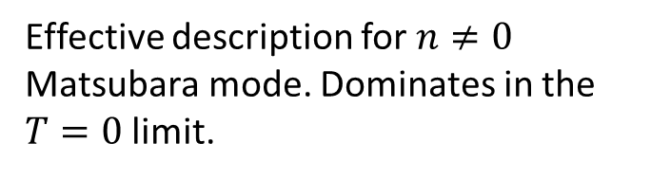
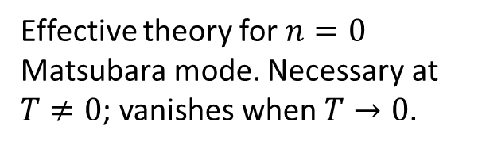
Problem in pQCD: infrared divergences at three-loop order from long-range (static) gauge fields
Solution: Resummation of IR sensitive contributions to the EoS: sum (certain) diagrams to infinite order or use EFT
Effective theory for $n=0$ Matsubara mode. Necessary at $T≠0$; vanishes when $T→0$.
Effective description for $n≠0$ Matsubara mode. Dominates in the $T=0$ limit.

Slide 16
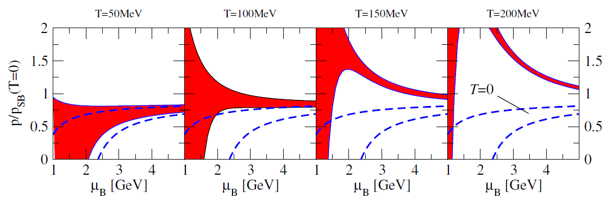
New: analytic result combining DR and HTL resummations →
Small temperatures under control [Kurkela, AV, Phys. Rev. Lett. 117, 042501]

Slide 17
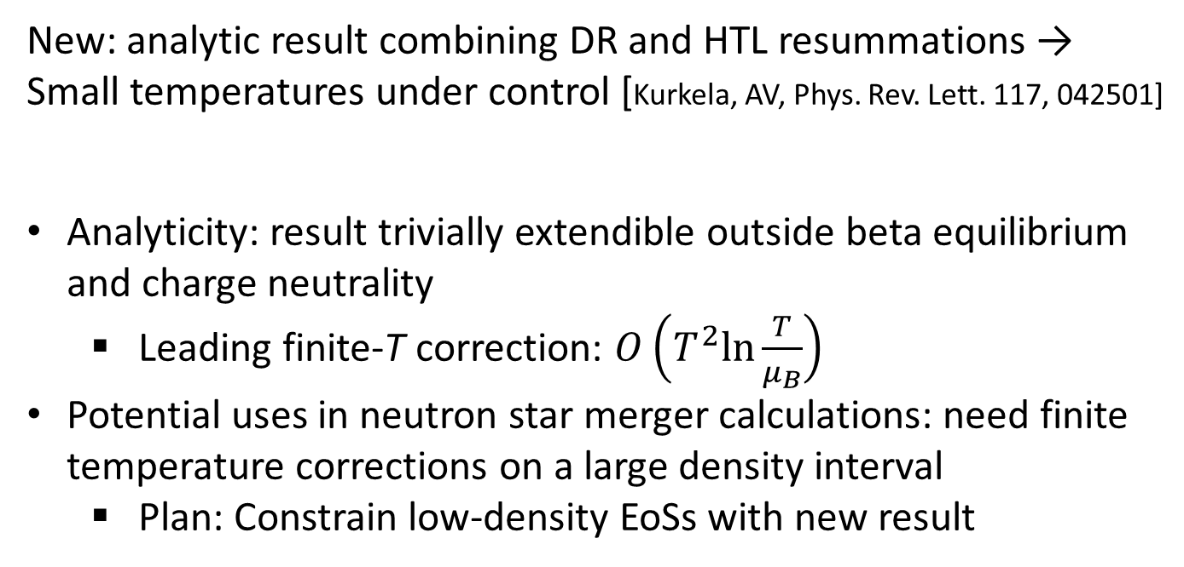
New: analytic result combining DR and HTL resummations → Small temperatures under control [Kurkela, AV, Phys. Rev. Lett. 117, 042501]
Analyticity: result trivially extendible outside beta equilibrium and charge neutrality
Leading finite-T correction: $O\left(T^{2}ln\frac{T}{μ_{B}}\right)$
Potential uses in neutron star merger calculations: need finite temperature corrections on a large density interval
Plan: Constrain low-density EoSs with new result

Slide 18
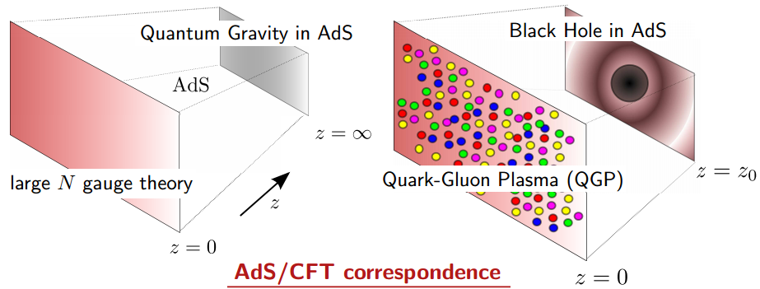
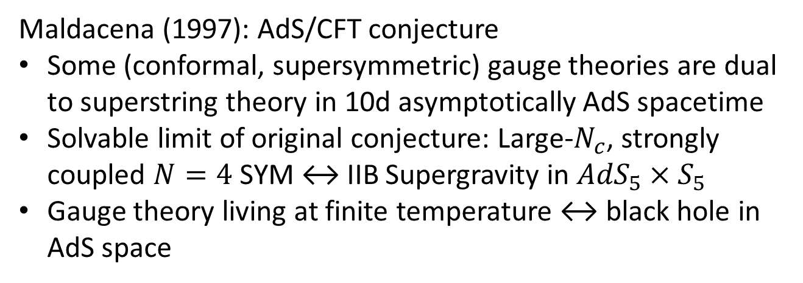
Maldacena (1997): AdS/CFT conjecture
Some (conformal, supersymmetric) gauge theories are dual to superstring theory in 10d asymptotically AdS spacetime
Solvable limit of original conjecture: Large-$N_{c}$, strongly coupled $N=4$ SYM ↔ IIB Supergravity in ${AdS}_{5}×S_{5}$
Gauge theory living at finite temperature ↔ black hole in AdS space

Slide 19
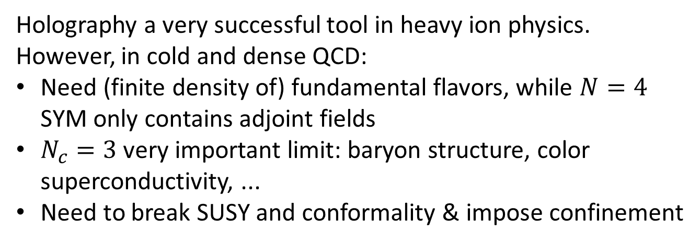
Holography a very successful tool in heavy ion physics. However, in cold and dense QCD:
Need (finite density of) fundamental flavors, while $N=4$ SYM only contains adjoint fields
$N_{c}=3$ very important limit: baryon structure, color superconductivity, ...
Need to break SUSY and conformality & impose confinement

Slide 20
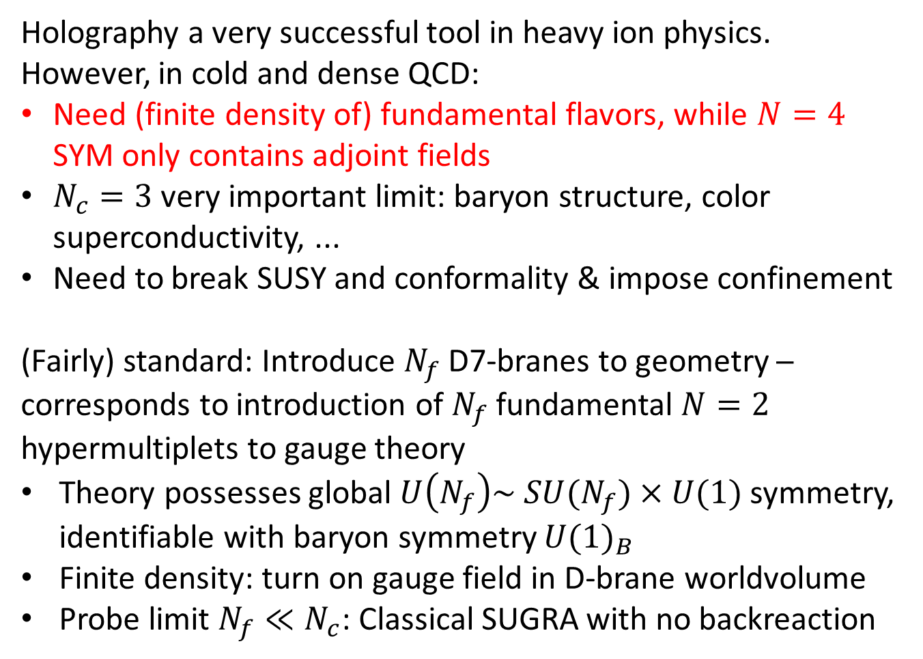
Holography a very successful tool in heavy ion physics. However, in cold and dense QCD:
Need (finite density of) fundamental flavors, while $N=4$ SYM only contains adjoint fields
$N_{c}=3$ very important limit: baryon structure, color superconductivity, ...
Need to break SUSY and conformality & impose confinement
(Fairly) standard: Introduce $N_{f}$ D7-branes to geometry ─ corresponds to introduction of $N_{f}$fundamental $N=2$ hypermultiplets to gauge theory
Theory possesses global $U\left(N_{f}\right)\sim SU(N_{f})×U(1)$ symmetry, identifiable with baryon symmetry ${U(1)}_{B}$
Finite density: turn on gauge field in D-brane worldvolume
Probe limit $N_{f}≪N_{c}$: Classical SUGRA with no backreaction

Slide 21
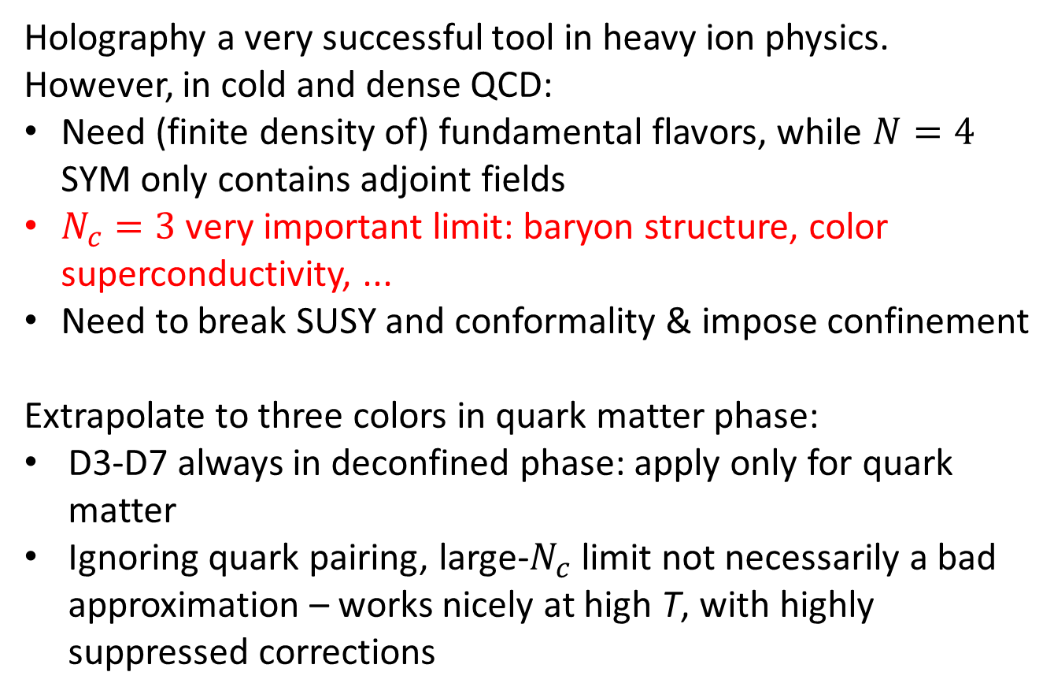
Holography a very successful tool in heavy ion physics. However, in cold and dense QCD:
Need (finite density of) fundamental flavors, while $N=4$ SYM only contains adjoint fields
$N_{c}=3$ very important limit: baryon structure, color superconductivity, ...
Need to break SUSY and conformality & impose confinement
Extrapolate to three colors in quark matter phase:
D3-D7 always in deconfined phase: apply only for quark matter
Ignoring quark pairing, large-$N_{c}$ limit not necessarily a bad approximation – works nicely at high T, with highly suppressed corrections

Slide 22
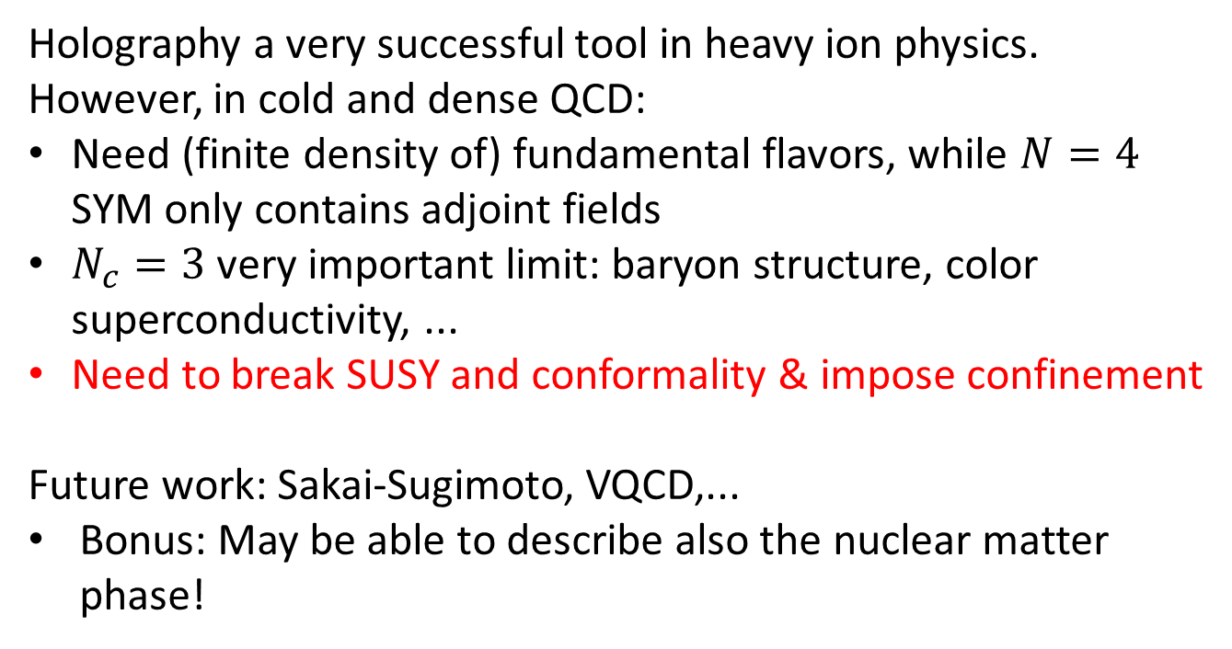
Holography a very successful tool in heavy ion physics. However, in cold and dense QCD:
Need (finite density of) fundamental flavors, while $N=4$ SYM only contains adjoint fields
$N_{c}=3$ very important limit: baryon structure, color superconductivity, ...
Need to break SUSY and conformality & impose confinement
Future work: Sakai-Sugimoto, VQCD,...
Bonus: May be able to describe also the nuclear matter phase!

Slide 23
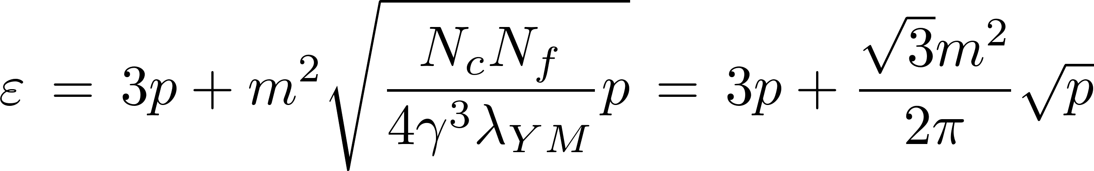
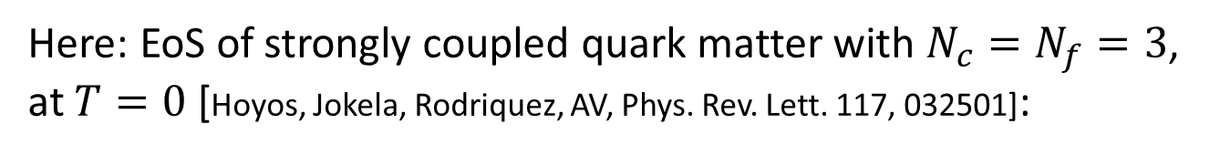
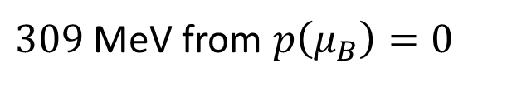
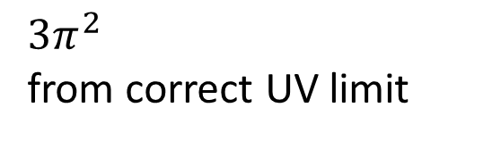
Here: EoS of strongly coupled quark matter with $N_{c}=N_{f}=3$, at $T=0$ [Hoyos, Jokela, Rodriquez, AV, Phys. Rev. Lett. 117, 032501]:
$309$ MeV from $p\left(μ_{B}\right)=0$
$3π^{2}$
from correct UV limit

Slide 24
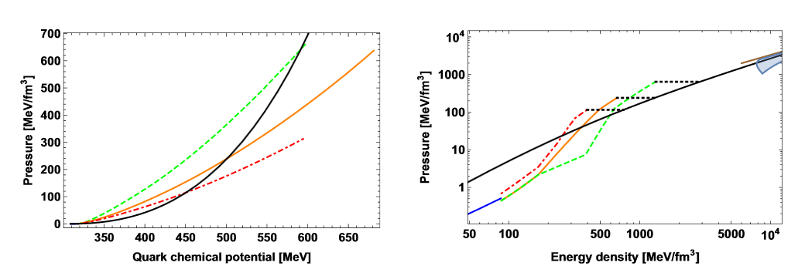
Matching to state-of-the-art CET nuclear matter EoSs:

Slide 25
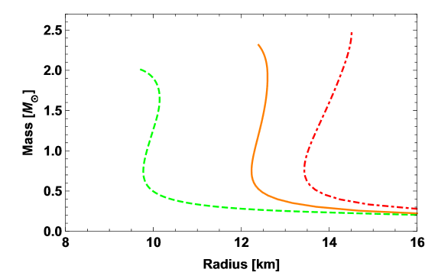
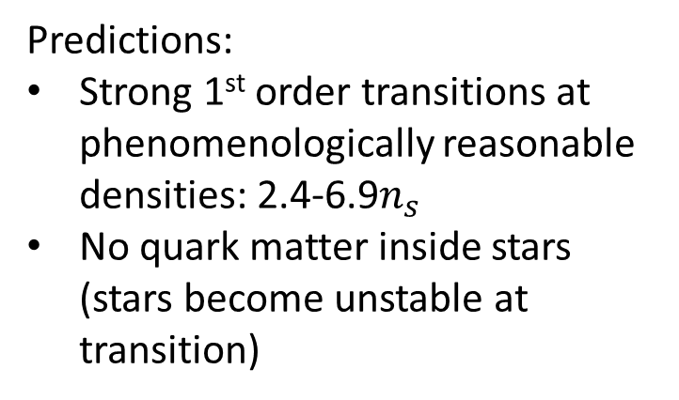
Matching to state-of-the-art CET nuclear matter EoSs:
Predictions:
Strong 1st order transitions at phenomenologically reasonable densities: 2.4-6.9$n_{s}$
No quark matter inside stars (stars become unstable at transition)

Slide 26
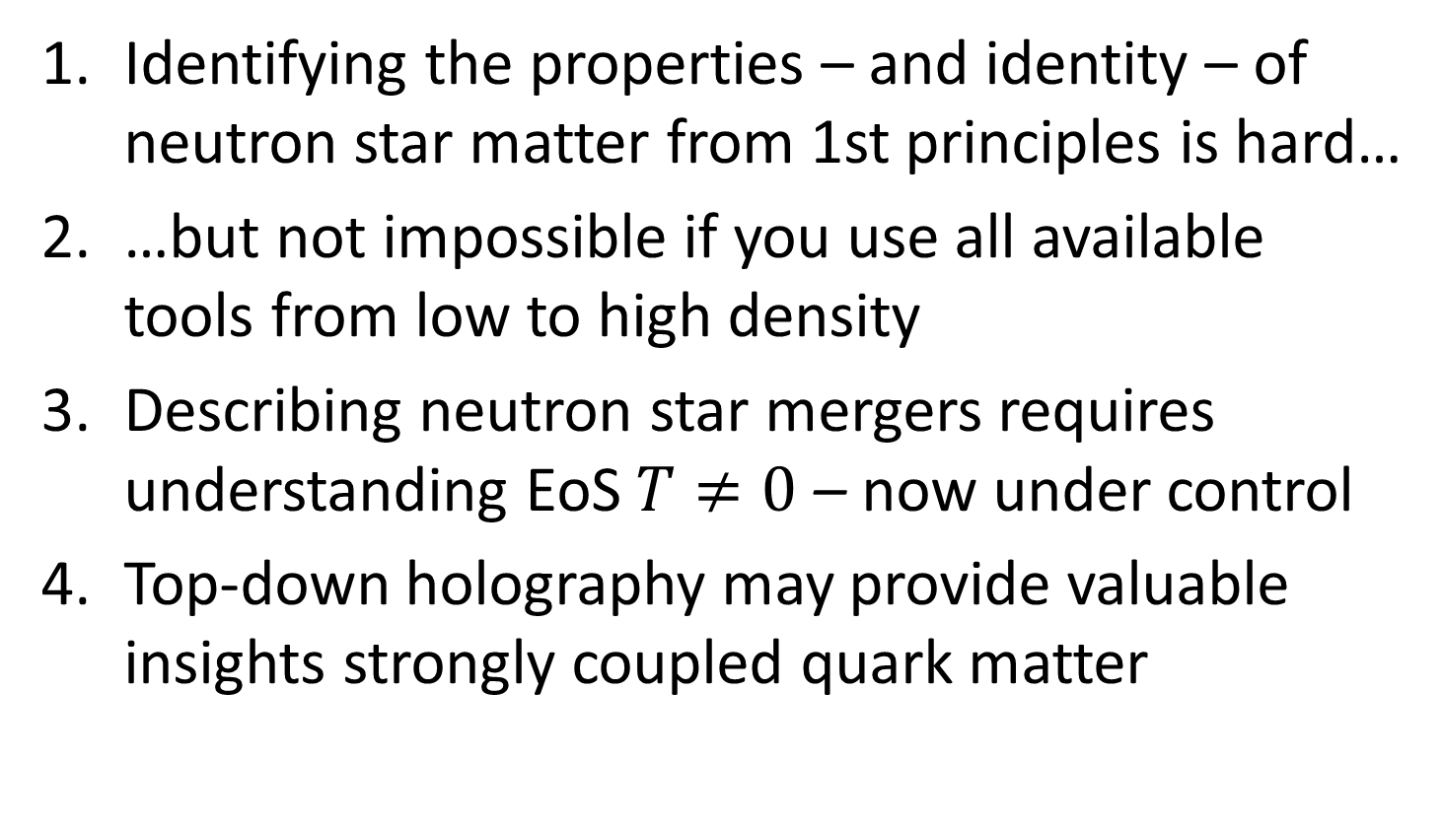
Final thoughts
Identifying the properties – and identity – of neutron star matter from 1st principles is hard…
…but not impossible if you use all available tools from low to high density
Describing neutron star mergers requires understanding EoS $T≠0$ – now under control
Top-down holography may provide valuable insights strongly coupled quark matter

