Slide 1
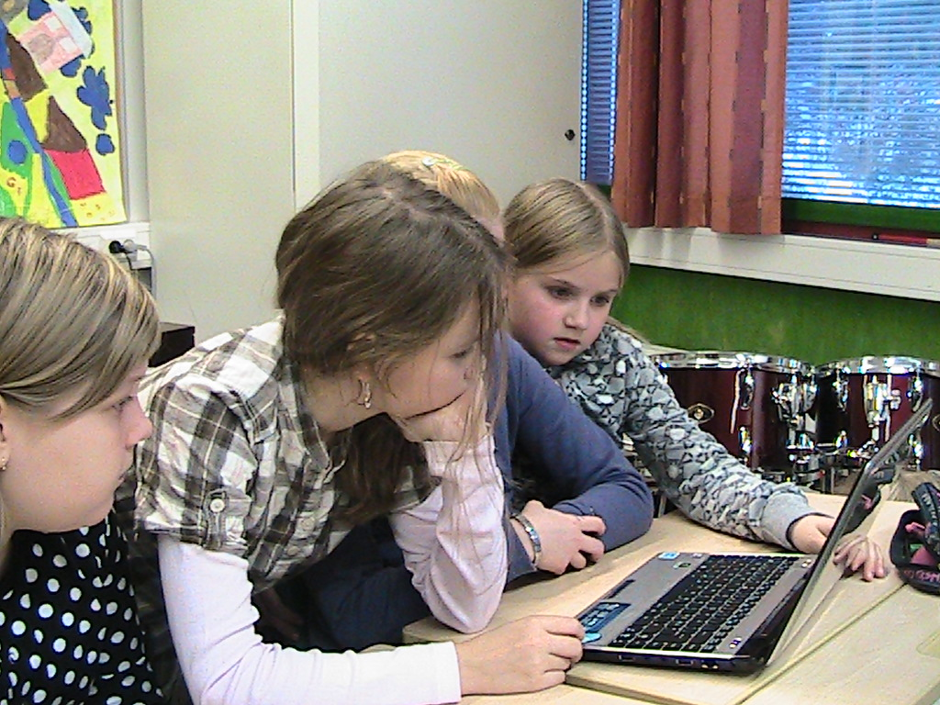
Innovative Teaching and Learning
Juho Norrena
26.5.2011

Slide 2
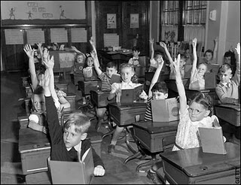

Slide 3
21st century skills - Finnish Forecast 2010
Change, knowledge, and lifelong learning
participants: 320 experts from universities, schools, companies, etc.
Sociability, collaboration
Sustainable development, humanity
Internationality, multiculturality
Substances, especially technology skills
Creativity, innovativeness
Individual skills

Slide 4
Supervisors
From Teacher Education in Computer Science:
senior assistant Leena Hiltunen and professor Tommi Kärkkäinen
From Agora Center:
professor Marja Kankaanranta
From Department of Teacher Education..?

Slide 5
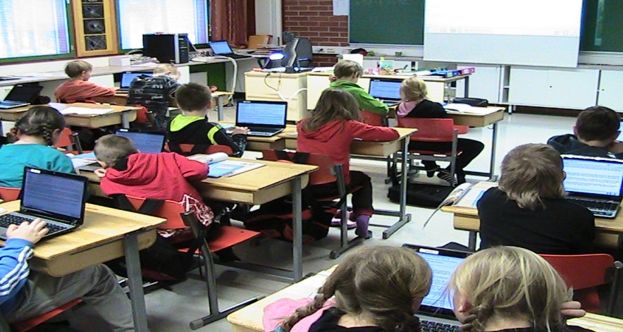
ITL: Collected data in Finland
(Pilot year+1st research year) 2009-10 and 2010-11
Surveys | 20+48 = 68 schools
Teacher survey | 292+541 = 833 responses
School leader survey | 18+44 = 62 responses
Site visits and collecting learning material | 6+6 = 12 schools
Teacher interviews School leader interviews Luokkahuonehavainnoinnit | 29 + 17 = 46 teachers 6 + 3 = 9 school leaders 24 + 15 = 39 lessons
Learning assignments | 117 + 144 = 261 assignments
Student work | 627 + 216 = 843 artifacts

Slide 6
My personal interests are…
…to think:
How the values impact on innovative teaching and learning?
And
What is the role of the traditional schooling in this?

Slide 7
Context and Inputs
Practices
Outcomes
National/Regional
Level
School/Teacher
Level
Classroom
Level
Student
Level
School Culture and Supports
National or Regional Education System
ICT Access and Support
Innovative Teaching Practices
Students’ 21st Century Skills
National or Regional
Program Supports
Educator Attitudes
Student-Centered Pedagogy
Extension of Learning Beyond the Classroom
ICT Integrated Into Teaching and Learning

Slide 8
Primary results
School / Teacher
level
School culture and support
National level
Learning space
Education system
Attitudes of school leaders and teachers
ICT access and support
Students’ 21st
century skills
Goals to develop schooling
Program support
Individual
agents
Pedag.
support
Traditional
orientation
External
agents
Innovative
teaching practices
Notes:
8

Slide 9
Coding learning activities
Use of ICT for Learning: Coding Rubric
4 = Students use ICT to support knowledge building AND they build knowledge that would be impractical or impossible without using ICT.
3 = Students use ICT to support knowledge building BUT they could build the same knowledge without using ICT.
2 = Students use ICT to learn or practice basic skills or reproduce information. They are not building knowledge.
1 = Students do not have the opportunity to use ICT for this learning activity.

